Slide 1
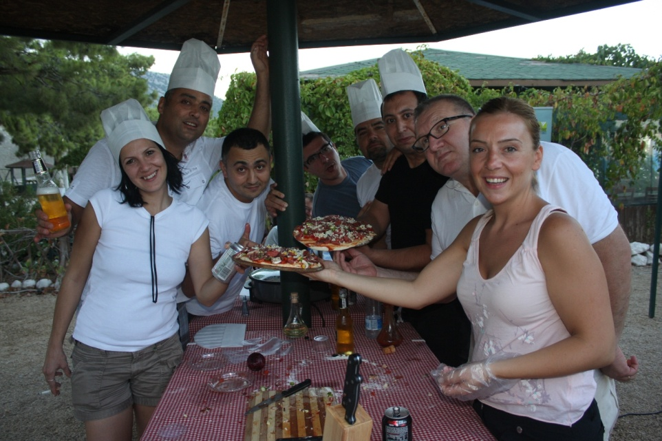
MIXED PIZZA MOTIVATION ACTIVITY 2015

Slide 2
[BENEFITS]
ELEMENTS ASSERTED BY THE “MIXED PIZZA“
Communication | Interaction | Self managed teams | Developing strategies
Self confidence | Time management | Different opinions | Synergy
Support&harmony | Trust in the team | Empathy | Proactive approach
Active problem solving | Motivation | Setting objectives | Adapting to the team
Outcome orientation | Helping each other | Sharing and responsibility | Leadership

Slide 3
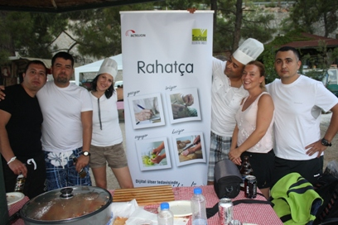
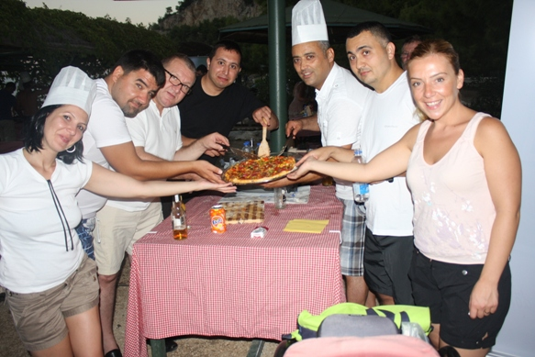
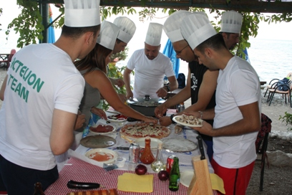
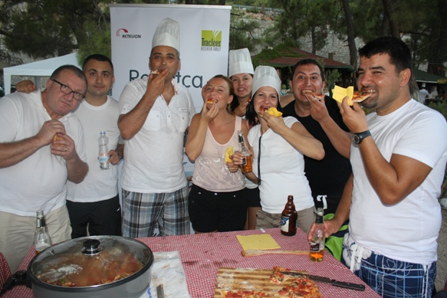
[STAGES OF “MIXED PIZZA”]
SEPARATING INTO TEAMS
PIZZAS ARE COOKING
GETTING THE INGREDIENTS READY
EATING THE PIZZAS WITH RELISH

Slide 4
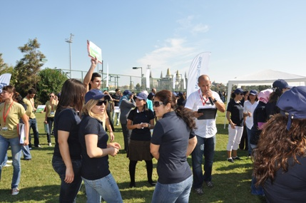
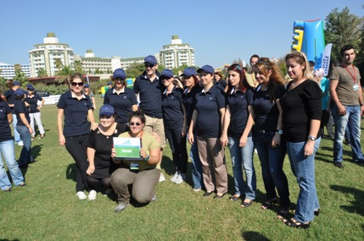
[GETTING ACQUAINTED AND FORMING TEAMS]
Objective;
Heating up and sharing information about the program
Informing about the activity
Getting to know the executive group
Grouping into predetermined teams
Accomodating the participants to the workshop environment

Slide 5
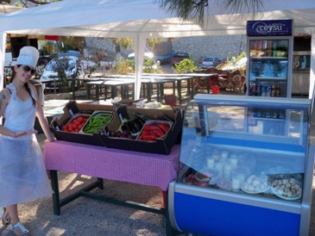
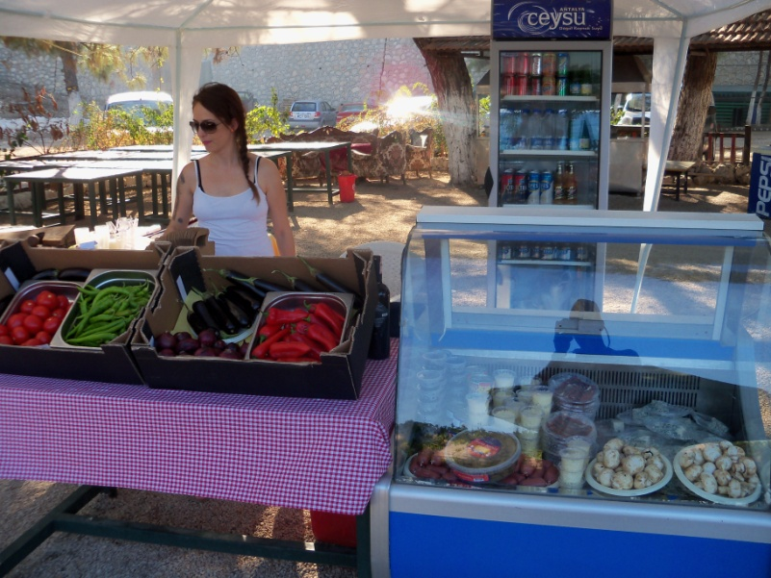
[CHOOSING THE INGREDIENTS]
Objective
Before startıng to cook teams decide what kınd of pizza they are going to prepare They start prepariıng it after gettıng the ingredients from the Pizza Market
Benefits
Team harmony
Communication
Problem solving
Sharıng ıdeas
Interaction
Different opinions

Slide 6
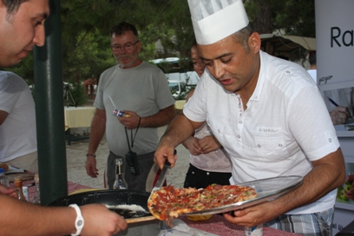
[COOKING THE PIZZA]
Objective
Pızza cooking kits are ready for the use of the partıcıpants After deciding what kind of a pizza they will cook, participants get the necessary ingredients from the market and start cooking
Benefits
Team harmony
Communication
Aesthetic reasoning
Sharing ideas
Interaction
Mutual aid

Slide 7
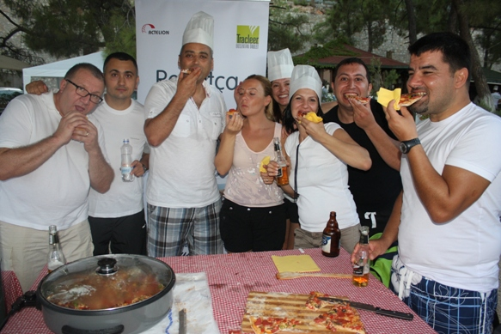
[FINALE]
Annnd
The pizzas are eaten by the participants with delight. Each team can make new pizzas using different materials

Slide 8
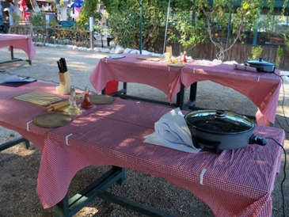
[PREPARATION AND SETUP]
Setup
Activity area is prepared one day beforehand Pizza preparation stations are set up Pizza Market is set up Necessary kitchen utensils and materials for the teams are placed in each station Last controls are carried out Last agreemets are reviewed

Slide 9
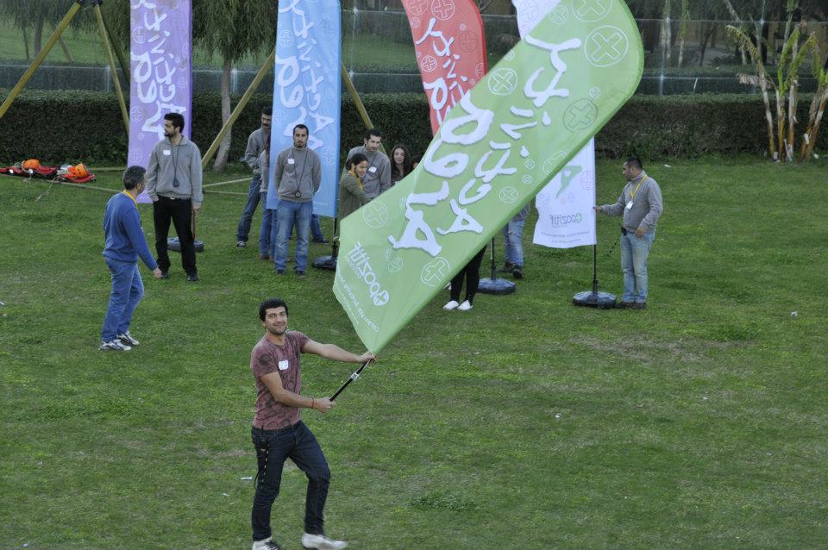
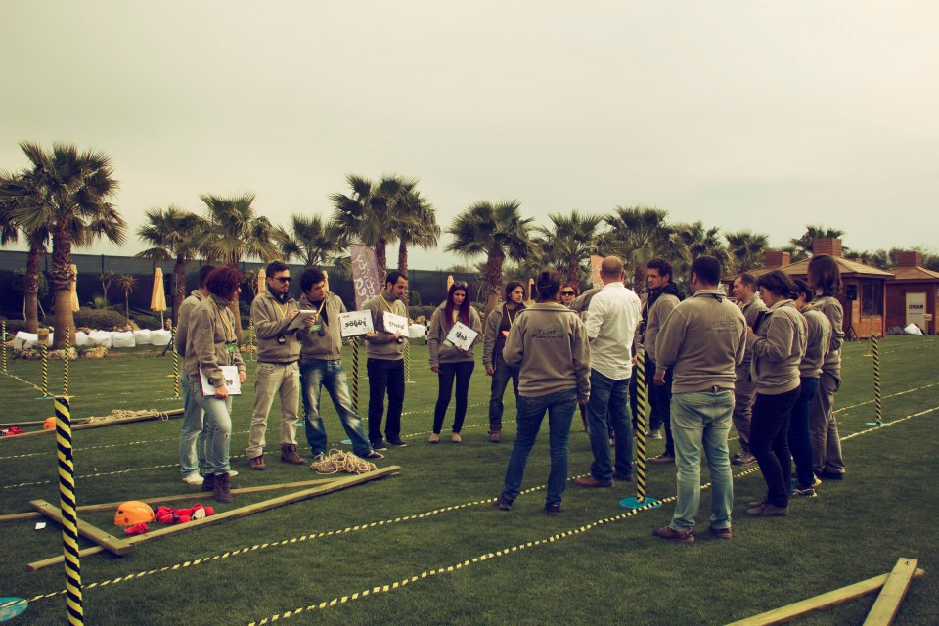
[EXECUTIVE TEAM]
Duties Of The Operation Team
Checking the teams and the time flow, Ensuring a smooth flow of the operation Ministering that the set-up is fully completed
Duties Of The Technical Team
Start setting-up one day before the activity Achieving field set-up Accomplishing cutting up with electric equipment
Duties Of The Activity Managers
Guiding the teams Assuring that the teams’ motivation keeps high Ensuring that the activities run parallel Evaluating the performences of the teams

Slide 10
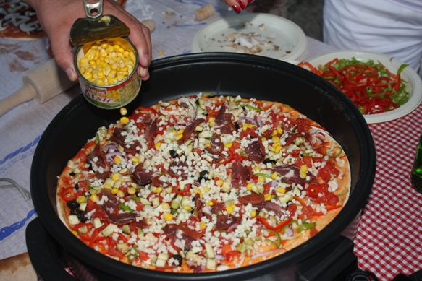
[PIZZA MENU]
MENU
Pizza Market Will Have Pizza Dough Mushrooms Olives Green and red peppers Red onions Tomatoes Mozarella Cheese Sucuk Salami Bacon Tuna Fısh Kaşar Cheese Necessary spices ve aromatics İn the Stations Pizza Souce Vegetable oil

Slide 11
[TIME TABLE]
ACTIVITY STEPS | TIME
GETTING ACQUAINTED AND HEATING UP | 15:00-15:15
PIZZA PREPARATION | 15:15-17:30

Slide 12
[COSTING]
Services That Are Included In The Proposal:
Execution of the activities in the program
Services That Are Not Included In The Proposal:
Permisson for the activity area and expenses for such, if required Personnel hosting expenses Transfer of personnel and all transportation expenses Awards and promotional materials, if required Hosting, food and drink expenses of the activity team during the activity working hours The sound system Professional photography and video recording.

Slide 13
[GRATITUDE]
THANKS A LOT

