Slide 1
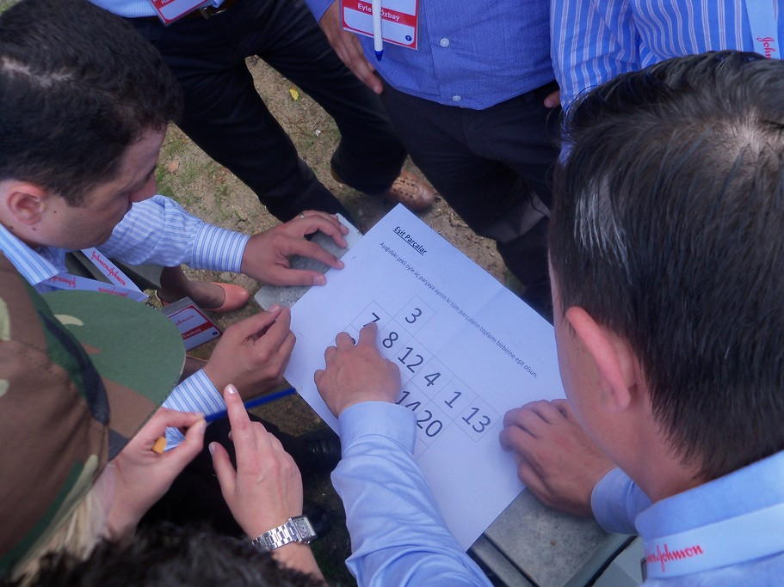
TREASURE HUNT TEAM WORK ACTIVITY 2015

Slide 2
[FICTION]
ACTIVITY | Treasure Hunt
FICTION | There is a treasure chest hidden in the hotel.Teams try to reach the chest following clues to its location.
EMPHASIS | Teams composed of the brand institutions members compete during the day to find the lost treasure.Importance of teamwork in the success of the institution is stressed.

Slide 3
[BENEFITS]
ELEMENTS ASSERTED BY THE “TREASURE HUNT“
Communication | Interaction | Self managed teams | Developing strategies
Self confidence | Time management | Different opinions | Synergy
Support&harmony | Trust in the team | Empathy | Proactive approach
Active problem solving | Motivation | Setting objectives | Adapting to the team
Outcome orientation | Helping each other | Sharing and responsibility | Leadership

Slide 4
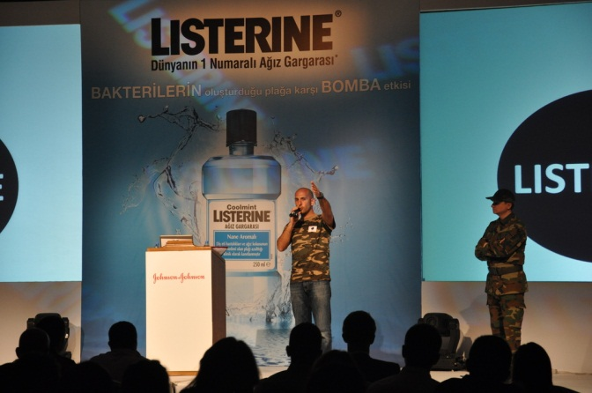
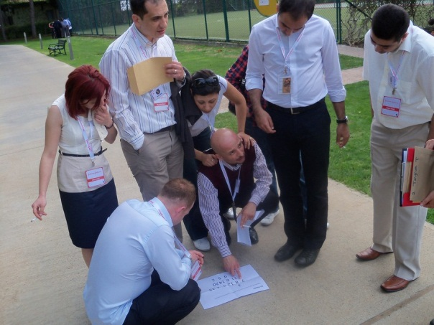
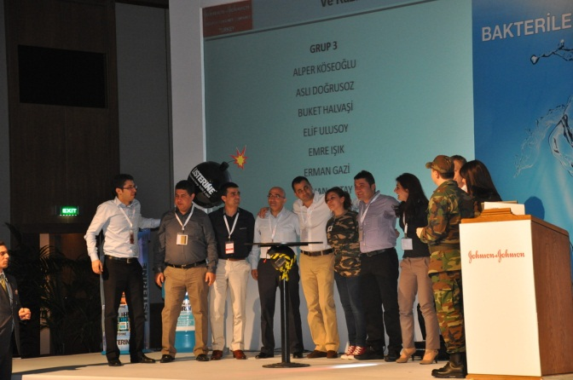
[STAGES OF “TREASURE HUNT”]
MEETING
CLUEDOS
MISSIONS
PLANNING
QUESTIONS
FINAL

Slide 5
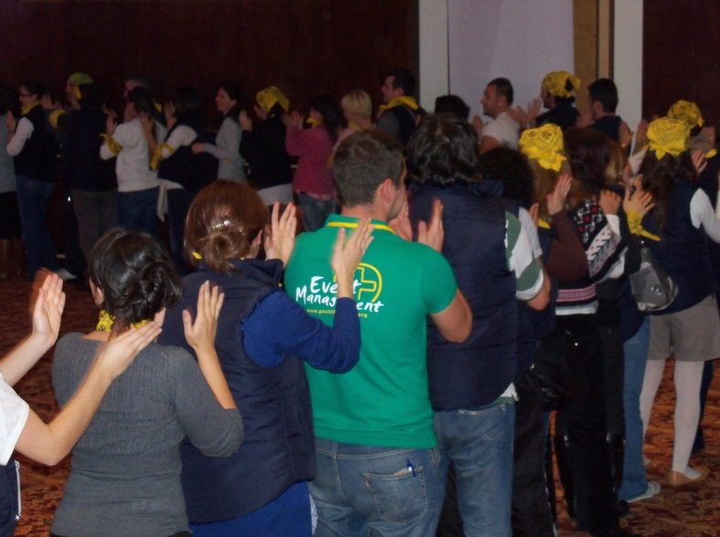
[GETTING ACQUAINTED AND FORMING TEAMS]
Objective;
Heating up and sharing information about the program
Informing about the activity
Getting to know the executive group
Grouping into predetermined teams
Accomodating the participants to the workshop environment

Slide 6
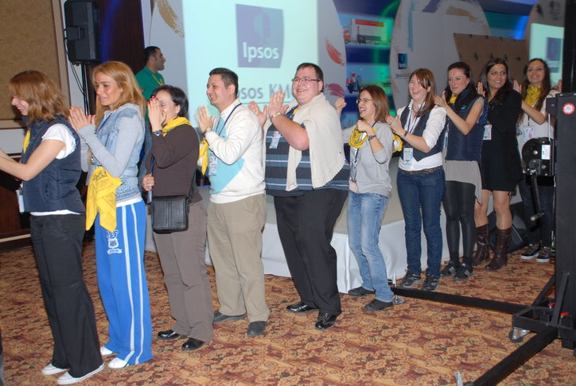
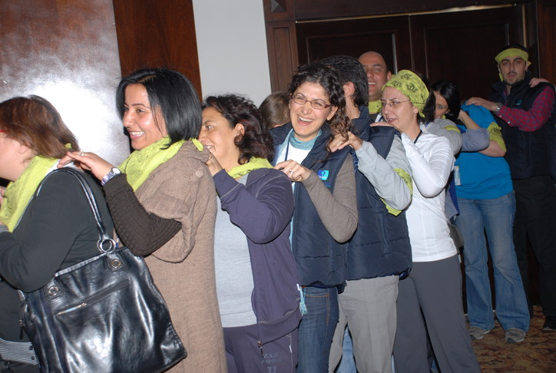
[HEATING UP ]
Massage therapy
Participants form a circle by coming together.Team members systematically massage each other before the activity.
Benefits
Teams getting used to each other
Teams getting used to the activity managers
Teams getting used to the activity environment
Synchronised action
Increased motivation
Interaction and helping each other
Teams getting used to each other

Slide 7
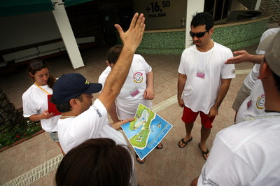
[PLANNING]
Objective
Guided by answers to questions, locating the points on the map. Getting nearer to the lost key of the chest at each step.
Benefits
Streessing strategy determination
Communication
Problem solving
Time management
Team haomony
Synchronised action
Sharing ideas
Decision making process

Slide 8
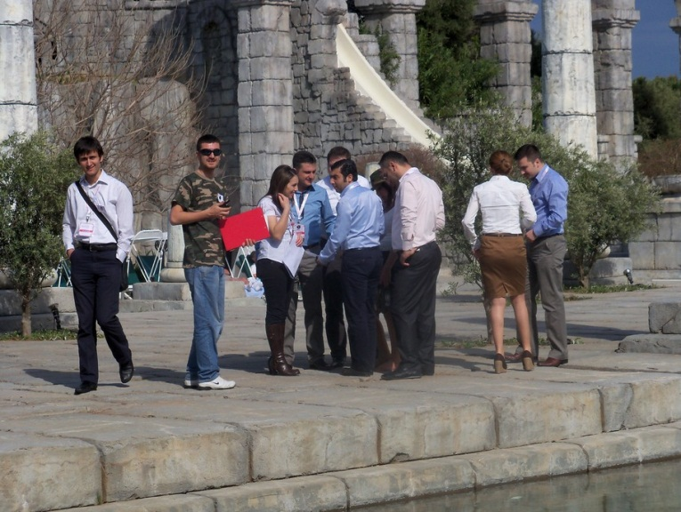
[ANSWERING THE QUESTIONS]
Objective
At each point on the map there are questions to be answered, problems to be solved. Teams can only move on to the next point by giving the right answers and finding logical solutions to problems
Benefits
Objective setting
Motivation
Problem solving
Team harmony
Self managing teams
Sharing ideas
Decision making process

Slide 9
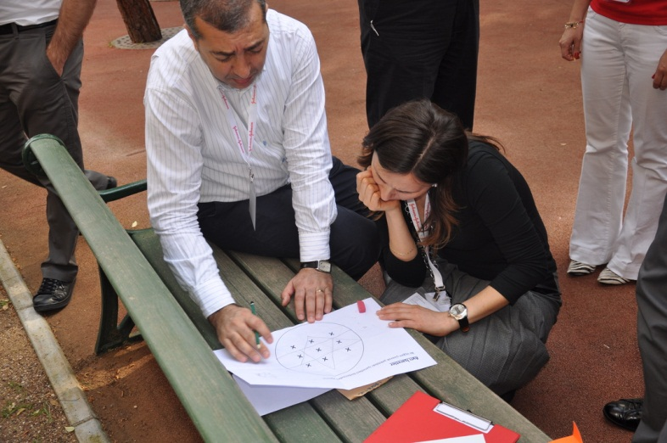
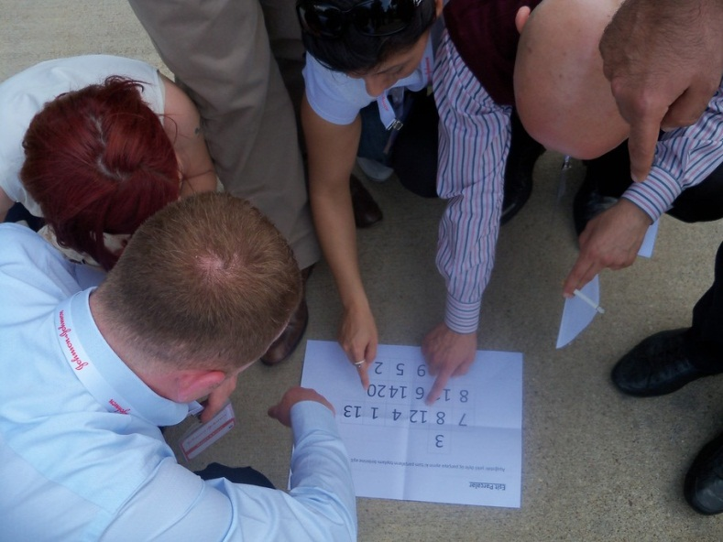
[COMPLETING DUTIES]
Objective
At some points, along with questions there are also duties to be fulfilled. Teams complete these duties to reach the next point.
Benefits
Identifying targets
Motivation
Problem solving
Team harmony
Trust within the teram
Sharing ideas
Feeling responsible

Slide 10
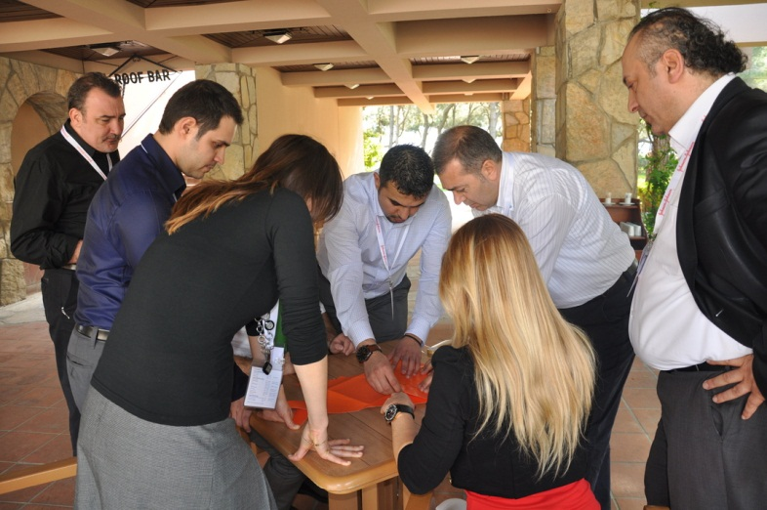
[REACHING THE TREASURE CHEST]
Objective
Teams answering all questions and completing all duties find the lost chest in the end
Benefits
Team harmony
Motivation
Problem solving
Trusting team members
Sharing ideas
Feeling responsible

Slide 11
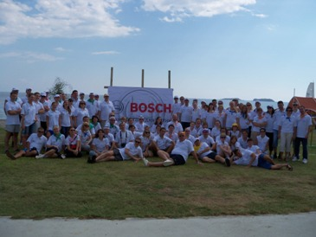
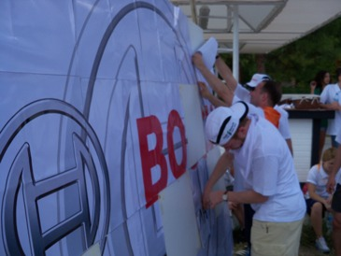
[FINALE]
And finally…
Every team finds a chest which contain parts of the company amblem at the last point . The amblem is completed by joining the parts in the chests. Completion is by the effort of all teams Teams which compete with each other during the game reach a common goal in the end.

Slide 12
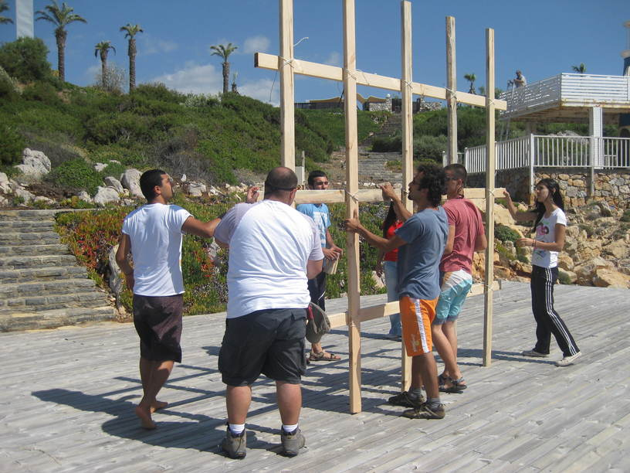
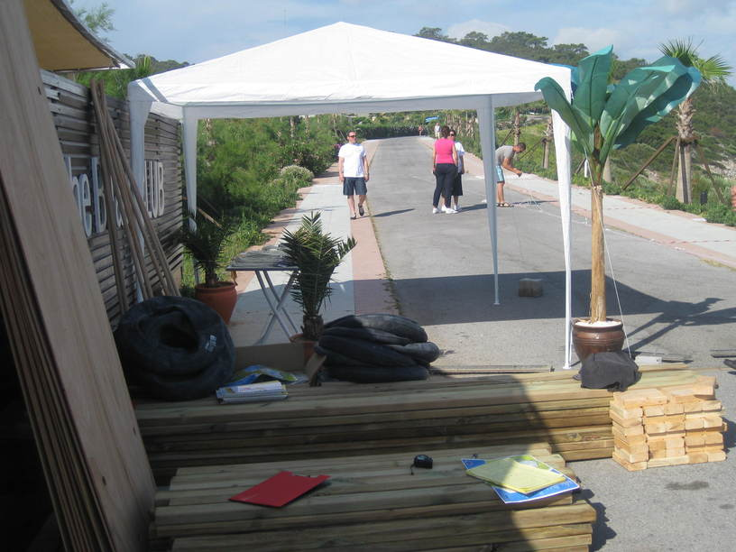
[PREPARATION AND SET-UP]
The set up is completed one day before the event
Activity arae is prepared Assembly stations are marked Required equipment and materials for the teeams are placed in each station Last rehersals are carried out with team managers Last checks are made Final agreements are settled

Slide 13
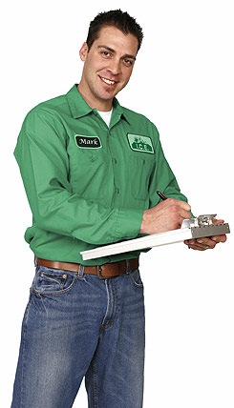
[EXECUTIVE TEAM]
Duties Of The Operation Team
Checking the teams and the time flow, Ensuring a smooth flow of the operation Ministering that the set-up is fully completed
Duties Of The Technical Team
Start setting-up one day before the activity Achieving field set-up Accomplishing cutting up with electric equipment
Duties Of The Activity Managers
Guiding the teams Assuring that the teams’ motivation keeps high Ensuring that the activities run parallel Evaluating the performences of the teams

Slide 14
[TIME TABLE]
ACTIVITY STEPS | TIME
INTRODUCTION &INFO | 14:00-14:05
SEPERATING INTO TEAMS | 14:05-14:15
HEATING | 14:15-14:20
ASSESSMENT | 14:20-14:30
QUESTIONS | 14:30-15:30
DUTIES | 15:30-16:00
REACHING THE TREASURE | 16:00
FINALE | 16:10

Slide 15
[COSTING]
Services That Are Included In The Proposal:
Execution of the activities in the program
Services That Are Not Included In The Proposal:
Permisson for the activity area and expenses for such, if required Personnel hosting expenses Transfer of personnel and all transportation expenses Awards and promotional materials, if required Hosting, food and drink expenses of the activity team during the activity working hours The sound system Professional photography and video recording.

Slide 16
[GRATITUDE]
THANKS A LOT

