Slide 1
SURVIVOR GAMES 2015

Slide 2
[BENEFITS]
ELEMENTS ASSERTED BY THE “SURVIVOR GAMES“
Communication | Interaction | Self managed teams | Developing strategies
Self confidence | Time management | Different opinions | Synergy
Support&harmony | Trust in the team | Empathy | Proactive approach
Active problem solving | Motivation | Setting objectives | Adapting to the team
Outcome orientation | Helping each other | Sharing and responsibility | Leadership

Slide 3
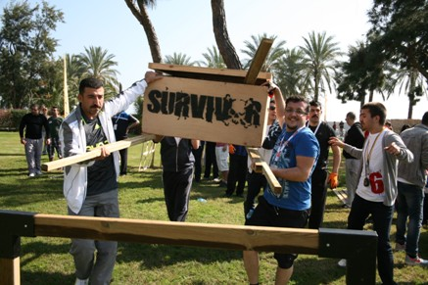
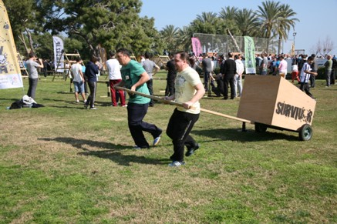
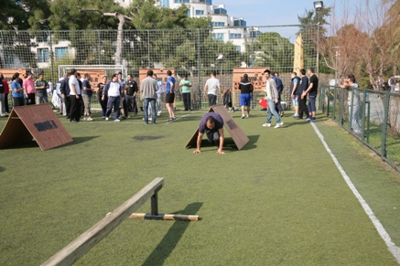
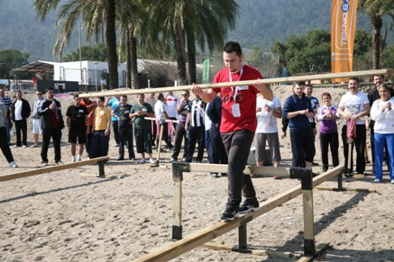
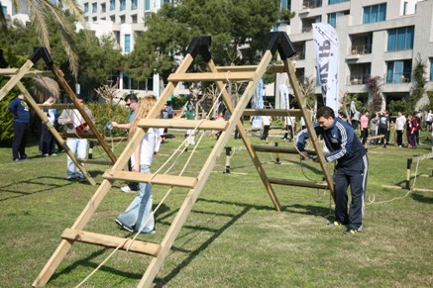
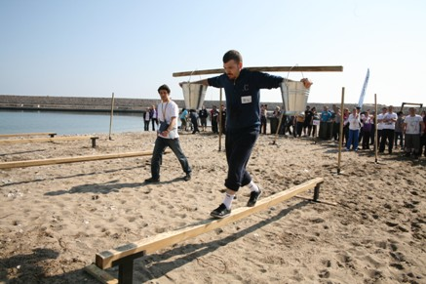
[ SURVIVOR GAMES]
CHEST
PORTER
REFLECTION
BALANCE VISUALS
ENDLESS ROPE
CARRYING WATER

Slide 4
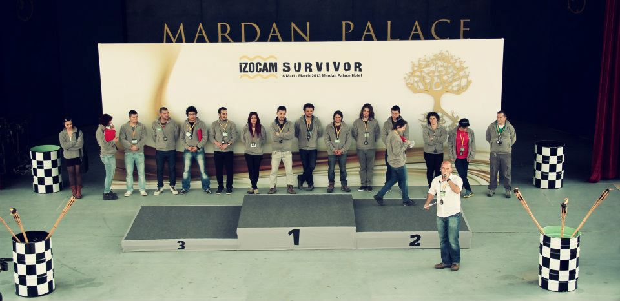
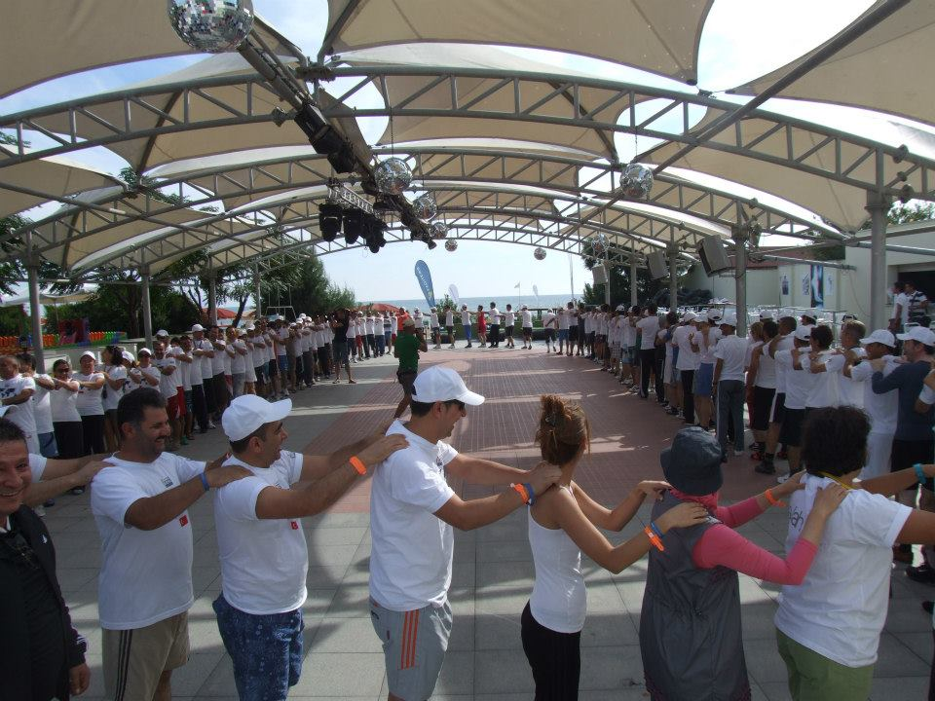
[GETTING ACQUAINTED AND FORMING TEAMS]
Objective;
Heating up and sharing information about the program
Informing about the activity
Getting to know the executive group
Grouping into predetermined teams
Accomodating the participants to the workshop environment

Slide 5
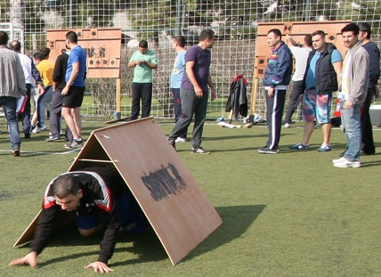
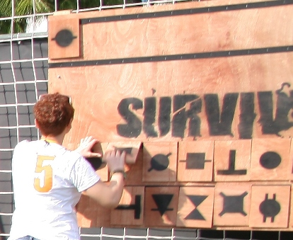
[SURVIVOR GAMES: REFLECTION]
Objective
There is a code written on the board. The participants try to copy this code to a blank panel at the end of a hurdle race course correctly and as soon as possible. Do not forget the code while overcoming the obstacles
Benefits
Problem solving
Fast reasoning
Interaction
Different opinions

Slide 6
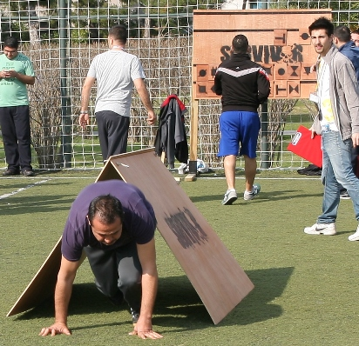
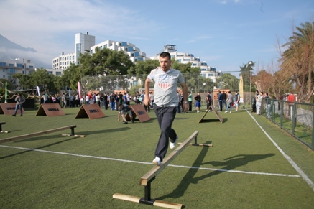
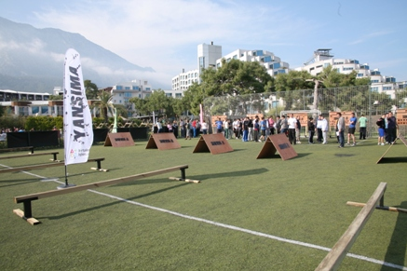
[SURVIVOR GAMES: REFLECTION IMAGES]

Slide 7
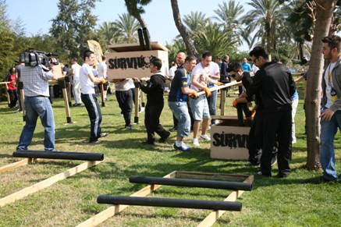
[SURVIVOR GAMES: CHEST]
Objective
Carrying the chest to the finish safely in a hurdle race course.
Benefits
Finding solutions collectively
Communication
Problem solving
Synchronised action
Quick thinking
Interaction
Different opinions

Slide 8
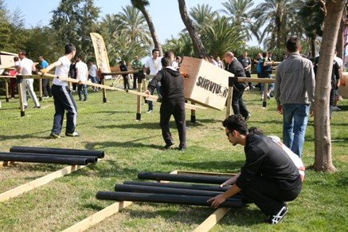
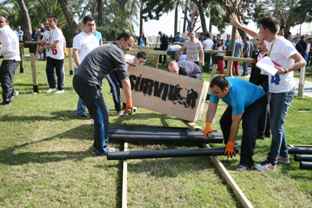
[SURVIVOR GAMES: CHEST IMAGES]

Slide 9
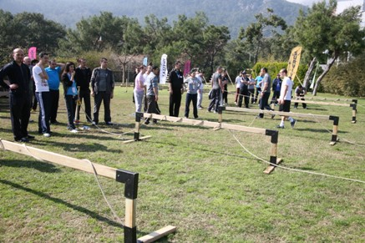
[SURVIVOR GAMES: ENDLESS ROPE]
Objective
A rope strches from the begining to the end of the course passing through some hurdels. We try to hang the ring in the rope to its place at the end passing it along the rope to the end of the course..
Benefits
Communication
Active problem solving
Synchronised action
Rapid thinking
Different opinions

Slide 10
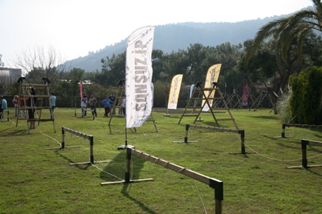
[SURVIVOR GAMES: ENDLESS ROPE]

Slide 11
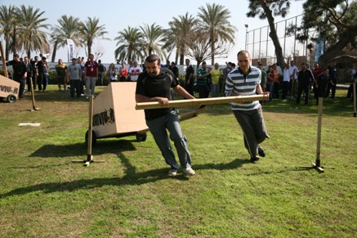
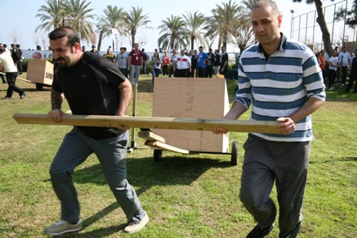
[SURVIVOR GAMES: PORTER]
Objective
Tring to collect the steps of the platform at the finish from amongst some barriers. We try to put the steps in their proper place on the platform and endeavor to reach the flag on top.
Benefits
Problem solving
Synchronised action
Rapid thinking
Interaction

Slide 12
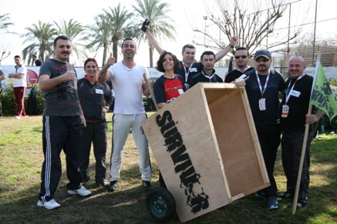
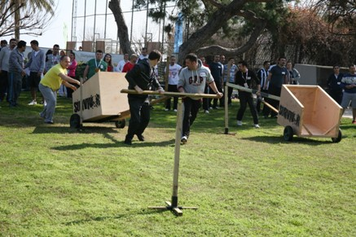
[SURVIVOR GAMES: PORTER IMAGES]

Slide 13
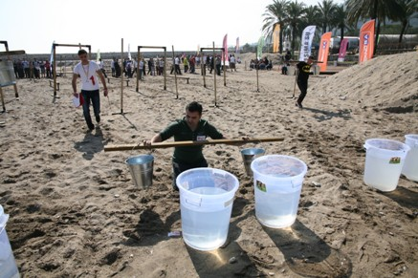
[SURVIVOR GAMES: CARRYING WATER]
Objective
Trying to pass through a course with sharp bends and narrow paths without spilling the water carried on our shoulders. Trying to fill up the reservoir at the end of the course within the shortest time.
Benefits
Communication
Problem solving
Synchronised action
Rapid thinking
Interaction
Different opinions
Communication

Slide 14
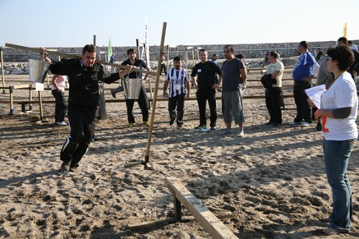
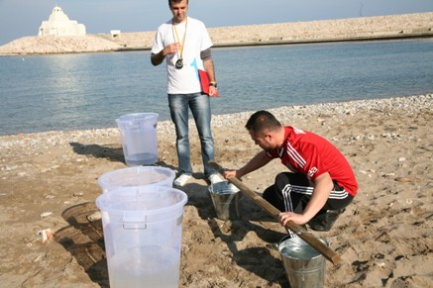
[SURVIVOR GAMES: CARRYING WATER IMAGES]

Slide 15
[TIME TABLE]
STEPS | TIME
GETTING ACQUAINTED & INFO | 13:00 -13:15
1. PHASE GAMES | 13:15 -13:45
2. PHASE GAMES | 14:00 -14:30
3. PHASE GAMES | 14:45 -15:15
4. PHASE GAMES | 15:30 -15:45
5. PHASE GAMES | 16:00 -16:30
6. PHASE GAMES | 16:15-16:30
FINALE | 17:00

Slide 16
[DISTRIBUTION OF THE TEAMS AND ROTATIONS]
Rotation
Initially teams within each color group will compete with each other. At the end of the day winning teams of each group compete again to decide on the most successful team of the day. While teams of the same color group are rivals in the beginning, they support their group’s best team in the finals. Each game set lasts for 30 minutes as stated in the program. After each 30 minutes, a 15 minute break is given All the games start and end simultaneously After the break the teams and the referee move on to the next game station, thus achieving a smooth flow of the action for all teams.

Slide 17
[DISTRIBUTION OF THE TEAMS AND ROTATIONS]
Rotation
Each station contains 6 different games Each color group has 7 game stations Each color group has 6 game platforms The diagram on the right shows a sample rotation plan A team which plays Game A will move on to Game B after 30 minutes. All teams start the games together, competing for 30 minutes and finish at the same time
A GAMES STATION
C GAMES STATION
D GAMES STATION
E GAMES STATION
F GAMES STATION
B GAMES STATION

Slide 18
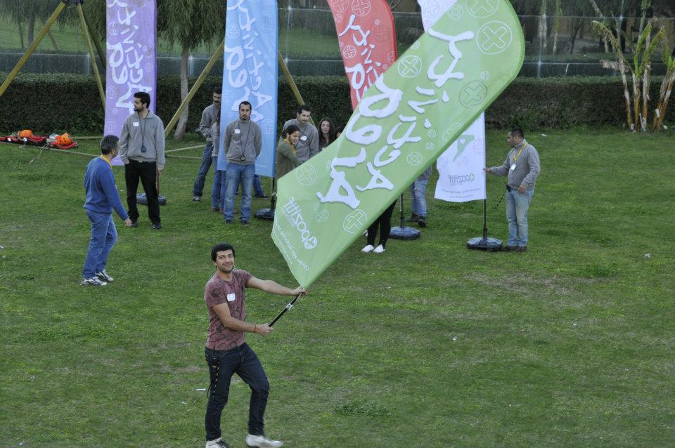
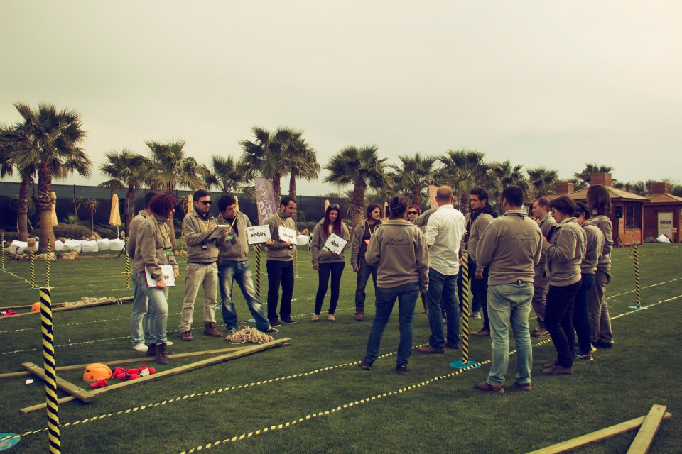
[EXECUTIVE TEAM]
Duties Of The Operation Team
Checking the teams and the time flow, Ensuring a smooth flow of the operation Ministering that the set-up is fully completed
Duties Of The Technical Team
Start setting-up one day before the activity Achieving field set-up Accomplishing cutting up with electric equipment
Duties Of The Activity Managers
Guiding the teams Assuring that the teams’ motivation keeps high Ensuring that the activities run parallel Evaluating the performences of the teams

Slide 19
[COSTING]
Services That Are Included In The Proposal:
Execution of the activities in the program
Services That Are Not Included In The Proposal:
Permisson for the activity area and expenses for such, if required Personnel hosting expenses Transfer of personnel and all transportation expenses Awards and promotional materials, if required Hosting, food and drink expenses of the activity team during the activity working hours The sound system Professional photography and video recording.

Slide 20
[GRATITUDE]
THANKS A LOT

