Slide 1
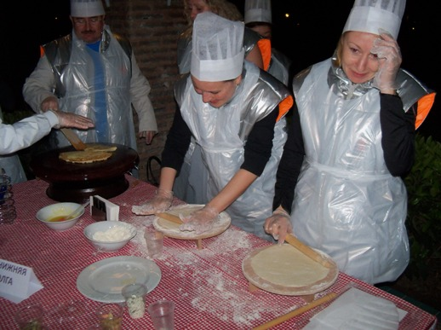
GOZLEME (PANCAKE) WORKSHOP MOTIVATION ACTIVITY 2015

Slide 2
[BENEFITS]
ELEMENTS ASSERTED BY THE “GOZLEME WORKSHOP“
Communication | Interaction | Self managed teams | Developing strategies
Self confidence | Time management | Different opinions | Synergy
Support&harmony | Trust in the team | Empathy | Proactive approach
Active problem solving | Motivation | Setting objectives | Adapting to the team
Outcome orientation | Helping each other | Sharing and responsibility | Leadership

Slide 3
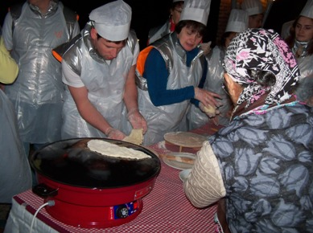
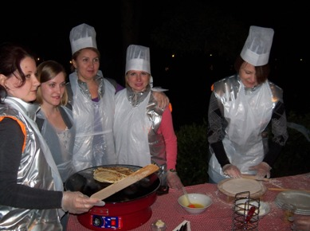
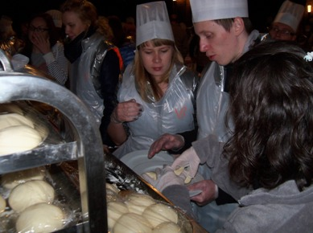
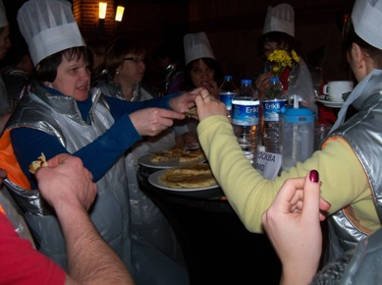
[STAGES OF “GOZLEME WORKSHOP”]
TEAMS
INFORMING
PREPARATION
EATING THE GOZLEMES

Slide 4
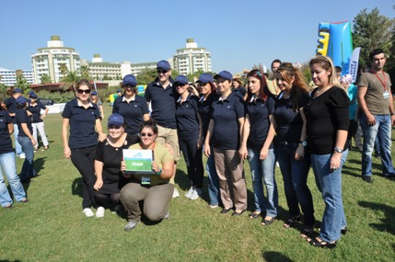
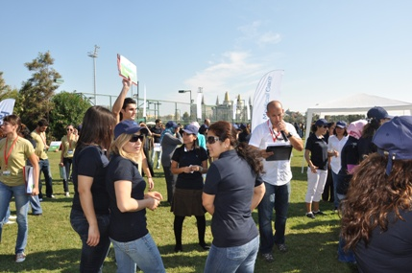
[GETTING ACQUAINTED AND FORMING TEAMS]
Objective;
Heating up and sharing information about the program
Informing about the activity
Getting to know the executive group
Grouping into predetermined teams
Accomodating the participants to the workshop environment

Slide 5
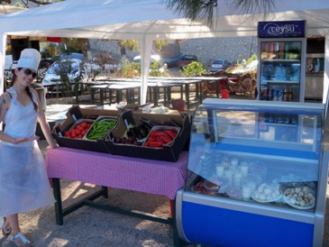
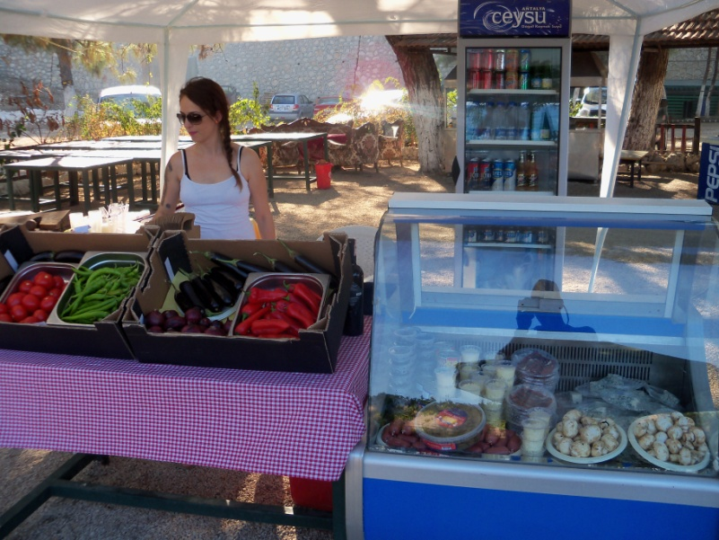
[CHOOSING THE INGREDIENTS]
Objective
Before startıng to cook teams decide what kınd of gözleme they are going to prepare They start prepariıng it after gettıng the ingredients from the Gözleme Market
Benefits
Team harmony
Communication
Problem solving
Sharıng ıdeas
Interaction
Different opinions

Slide 6
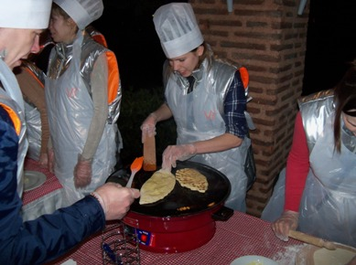
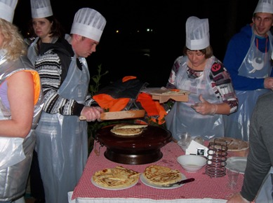
[COOKING]
Objective
Gözleme cooking kıts are ready for the use of partıcıpants After deciding what kind of a gözleme they will cook, participants get the necessary ingredients from the market and start cooking
Benefits
Team harmony
Communication
Aesthetic reasoning
Sharing ideas
Interaction
Mutual aid

Slide 7
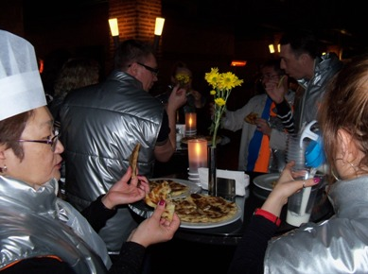
[FINALE]
Annnd
The gözlemes are eaten by the participants with delight. Each team can make new gözlemes using different materials

Slide 8
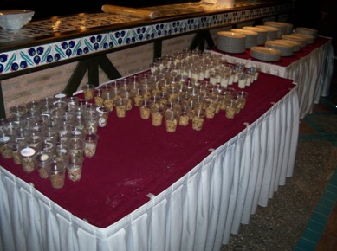
[GOZLEME SET UP]
In Each Stations
Tables for rolling out dough
Dough roller
Gözleme cooking machine
For common use
Salt, black peppers, oil, etc.
To put inside the gözleme(cheese, minced meat, spinach, patotoes etc.)

Slide 9
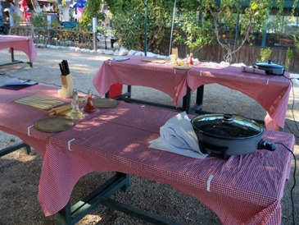
[PREPARATION AND SET-UP]
Setup
Activity area is prepared one day beforehand Gözleme preparation stations are set up Gözleme Market is set up Necessary kitchen utensils and materials for the teams are placed in each station Last controls are carried out Last agreemets are reviewed.

Slide 10
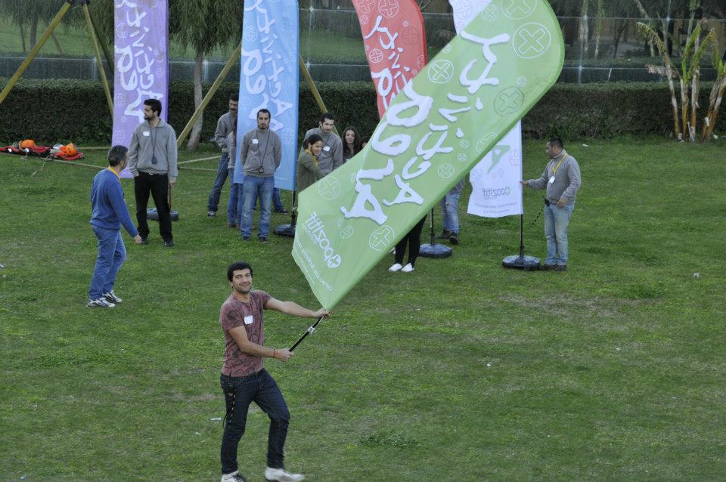
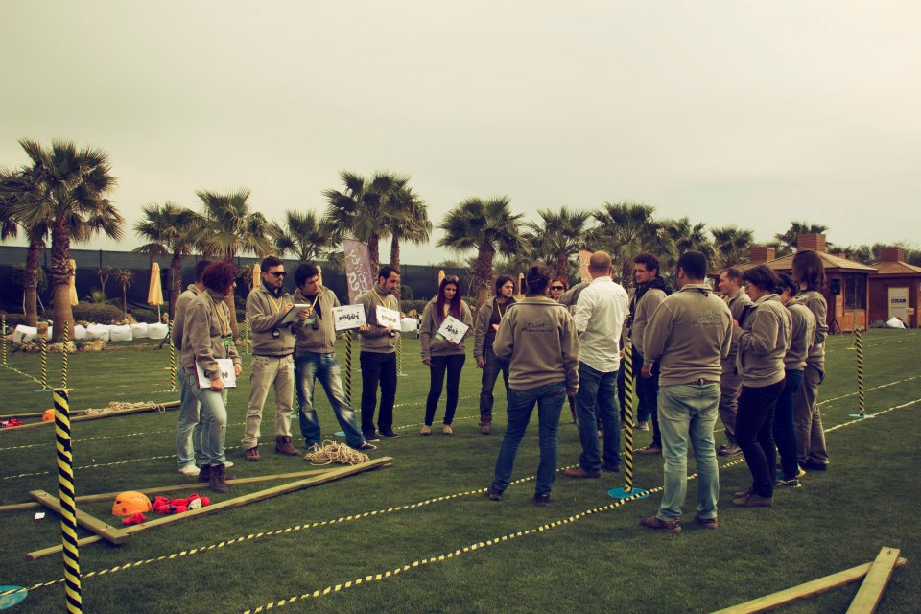
[EXECUTIVE TEAM]
Duties Of The Operation Team
Checking the teams and the time flow, Ensuring a smooth flow of the operation Ministering that the set-up is fully completed
Duties Of The Technical Team
Start setting-up one day before the activity Achieving field set-up Accomplishing cutting up with electric equipment
Duties Of The Activity Managers
Guiding the teams Assuring that the teams’ motivation keeps high Ensuring that the activities run parallel Evaluating the performences of the teams

Slide 11
[TIME TABLE]
ACTIVITY STEPS | TIME
ACQUAINTANCE&INFO | 15:00-15:15
GÖZLEME PREPARATIONS | 15:15-17:30

Slide 12
[COSTING]
Services That Are Included In The Proposal:
Execution of the activities in the program
Services That Are Not Included In The Proposal:
Permisson for the activity area and expenses for such, if required Personnel hosting expenses Transfer of personnel and all transportation expenses Awards and promotional materials, if required Hosting, food and drink expenses of the activity team during the activity working hours The sound system Professional photography and video recording.

Slide 13
[GRATITUDE]
THANKS A LOT

