Slide 1
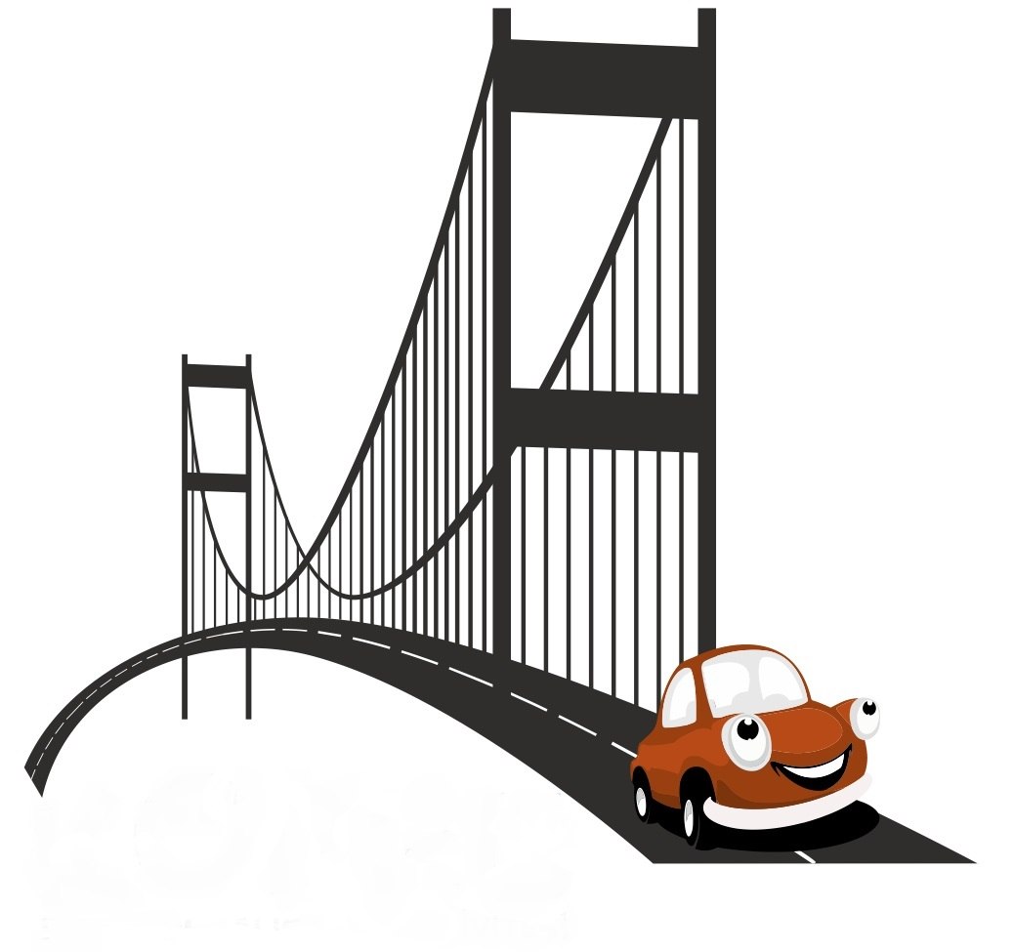
THE BRIDGE TEAMWORK ACTIVITY 2015

Slide 2
[FICTION ]
FICTION | Initially teams build sections of a bridge from the materials provided. Then joining the pieces they build a large bridge.The constructed bridge should be large, stable and strong enough to support a big and heavy remote controlled vehicle. At the end, the teams will be evaluated by vote in categories of: Best design Best trademark emphasis Most efficient use of materials
EMPHASIS | Teams made up of the units within the company compete during the day to be the best. As the teams compete with each other in the categories of design, performance and service, the related sector is recalled. The significance of working as a team to achieve the success of the institution is emphasised.

Slide 3
[BENEFITS]
ELEMENTS ASSERTED BY THE “THE BRIDGE“
Communication | Interaction | Self managed teams | Developing strategies
Self confidence | Time management | Different opinions | Synergy
Support&harmony | Trust in the team | Empathy | Proactive approach
Active problem solving | Motivation | Setting objectives | Adapting to the team
Outcome orientation | Helping each other | Sharing and responsibility | Leadership

Slide 4
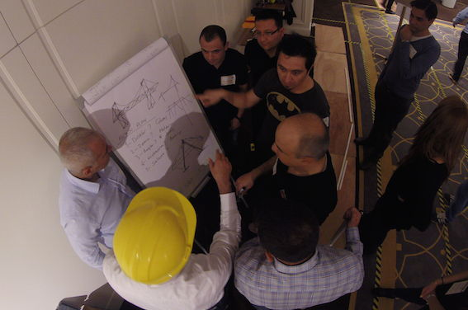
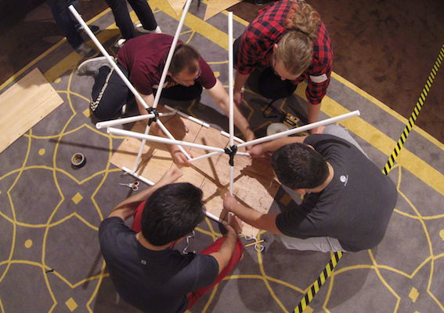
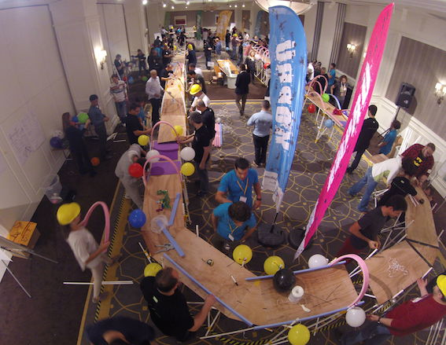
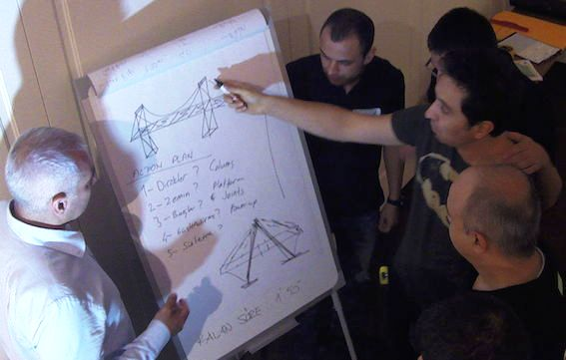
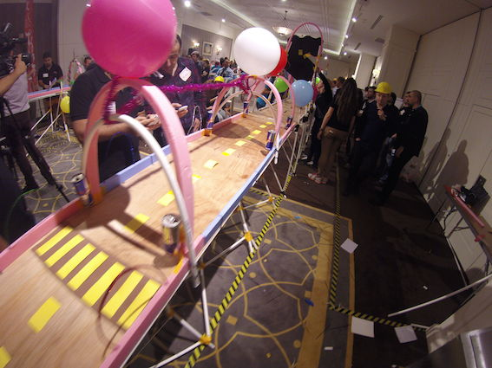
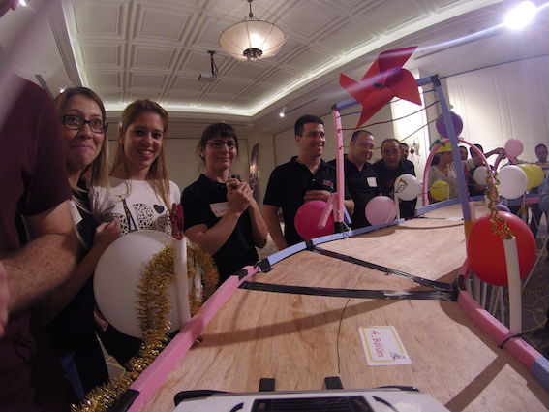
[THE BRIGDE STEPS]
INFORMATION
BRIDGE CONTRUCTION
JOINING UP
PROJECT PROCESS
DECOR AND DESIGN
TEST DRIVE

Slide 5
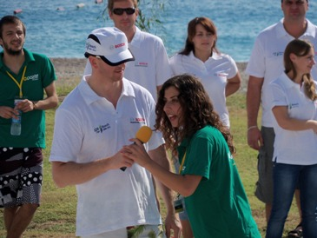
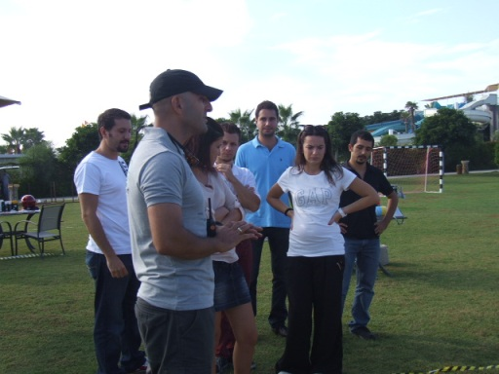
[GETTING ACQUAINTED AND FORMING TEAMS]
Objective;
Heating up and sharing information about the program
Informing about the activity
Getting to know the executive group
Grouping into predetermined teams
Accomodating the participants to the workshop environment

Slide 6
[PROJECT ASSESSMENT]
Objective
To assess the project and form a strategy Designing the ideal bridge using the materials provided.. To work in close collaboration with other teams to complete the bridge from sections made by each team. Moving parallel all together towards the common objective.
Benefit
Common resource use
Communication
Problem solving
Synchronised action
Sharing ideas
The decision process
Etkileşim

Slide 7
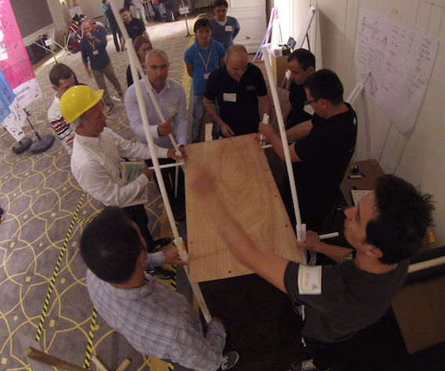
[INSTALLATION-SETUP]
Objective
Once needs are identified, the distribution of tasks is made. The teams have to make accurate calculations to make best use of the available bridge materials Teams have to consider that the bridge has to be strong, stable and wide enough for a test drive by a remote controlled vehicle.
Benefits
Common resource use
Communication
Problem solving
Synchronised action
Self managing teams
Decision process
Interaction

Slide 8
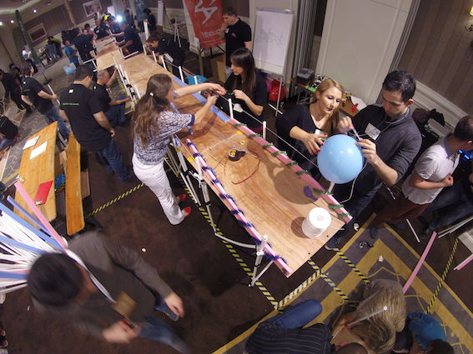
[VISUALS]
Objective
The bridge imagined by the teams is given life with creativeness With imagination,teams try to make the best designs of bridge parts by using a limited amount of material Teams will enjoy their work while brand name and teamwork is stressed at the same time
Benefits
Creativeness
Communication
Stressing the barnd name
Forming concepts
Synergy
Development of the team spirit
Interaction

Slide 9
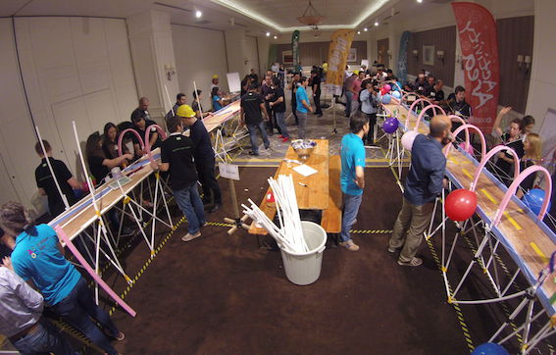
[SETUP]
Objective
. After constructing their sections teams bring the pieces together. Discrepancies between the levels of the pieces are rapidly amended Finally by rigging with visuals the bridge gets completed in appearance as well
Benefits
Team harmony
Communication
Stressing the brand name
Support and motivation
Synergy
Development of the team spirit
Interaction

Slide 10
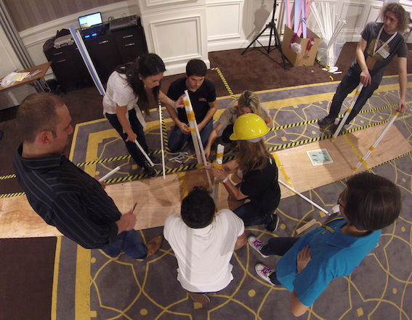
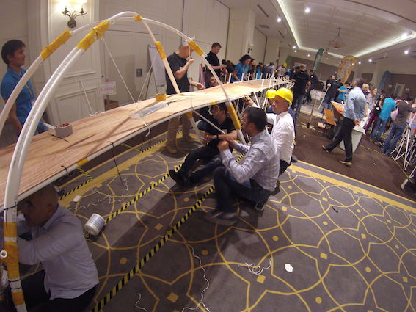
[CHOOSING THE BEST]
Objective
Jury chooses the best teams according to predetermined categories: Best design Best trademark emphasis Most effective use of materials
Benefits
Team harmony
Communication
Stressing the brand name
Support and motivation
Synergy
Development of the team spirit
Interaction

Slide 11
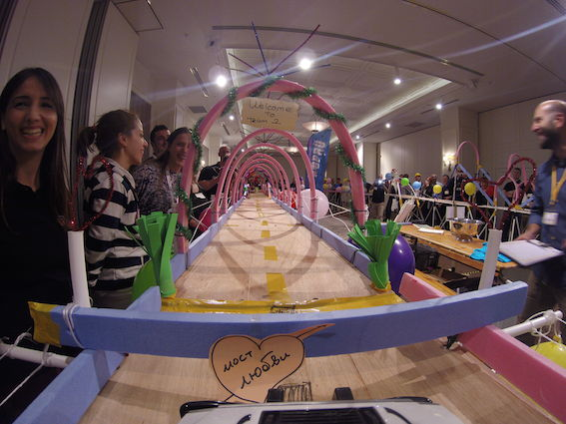
[CONCLUSION AND AWARDS]
Objective
All through the day teams construct parts of a bridge which are joined at the end of the day After the bridge is completed in appearance as well, test driving takes place During the test a large, wide and heavy remote controlled vehicle is driven over the bridge. If it holds on, the bridge is considered to be successfully constructed.
Benefits
Common goal
The feeling of mutual accomplishment
Support and motivation
Development of the team spirit.
Communication

Slide 12
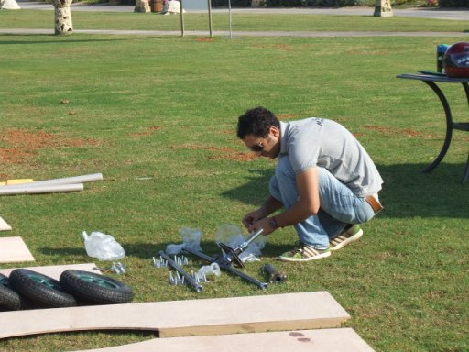
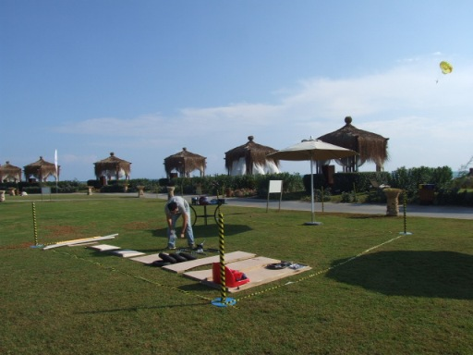
[PREPARATION AND SETUP]
The set up is completed one day before the event
Activity arae is prepared Assembly stations are marked Required equipment and materials for the teeams are placed in each station Last rehersals are carried out with team managers Last checks are made Final agreements are settled

Slide 13
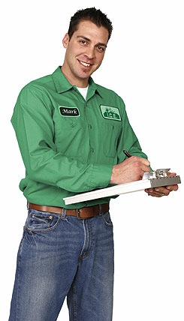
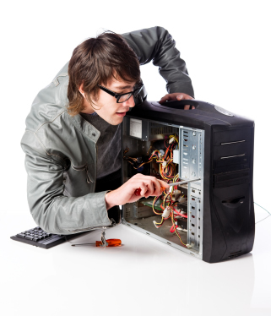
[EXECUTIVE TEAM]
Duties Of The Operation Team
Checking the teams and the time flow, Ensuring a smooth flow of the operation Ministering that the set-up is fully completed
Duties Of The Technical Team
Start setting-up one day before the activity Achieving field set-up Accomplishing cutting up with electric equipment
Duties Of The Activity Managers
Guiding the teams Assuring that the teams’ motivation keeps high Ensuring that the activities run parallel Evaluating the performences of the teams

Slide 14
[TIME TABLE]
ACTIVITY STEPS | TIME
ACQUAINTANCE&INFO | 13:30-13:45
PROJECT ASSESSMENT | 13:45-14:30
ASSEMBLY | 14:30-15:30
IMAGINATION AND DESIGN | 15:30-16:00
CONSTRUCTING THE BRIDGE | 16:00-16:40
TEST DRIVE | 16:40-17:00
FINALE | 17:00

Slide 15
[COSTING]
Services That Are Included In The Proposal:
Execution of the activities in the program
Services That Are Not Included In The Proposal:
Permisson for the activity area and expenses for such, if required Personnel hosting expenses Transfer of personnel and all transportation expenses Awards and promotional materials, if required Hosting, food and drink expenses of the activity team during the activity working hours The sound system Professional photography and video recording.

Slide 16
[GRATITUDE]
THANKS A LOT

