Slide 1
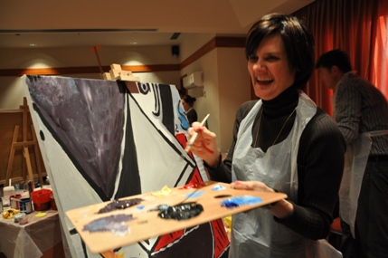
THE BIG PICTURE TEAMWORK ACTIVITY 2015

Slide 2
[FICTION ]
ACTIVITY | The Big Picture
FICTION | In this activity the participants are asked to paint one part of a great picture as a team. While the participants can not get any meaning from the piece alone, they know that it is a part of a greater whole. Each team tries to paint their piece as perfect as possible. Pieces of the great picture painted on empty canvases are then brought together to form the whole picture, with pieces of diverse styles.
EMPHASIS | Teams composed of company employees act together during the day for a common goal. The significance of working as a team to achieve the success of the institution is emphasised.

Slide 3
[BENEFITS]
ELEMENTS ASSERTED BY THE “THE BIG PICTURE“
Communication | Interaction | Self managed teams | Developing strategies
Self confidence | Time management | Different opinions | Synergy
Support&harmony | Trust in the team | Empathy | Proactive approach
Active problem solving | Motivation | Setting objectives | Adapting to the team
Outcome orientation | Helping each other | Sharing and responsibility | Leadership

Slide 4
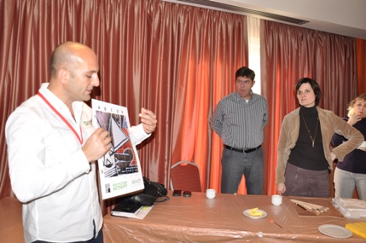
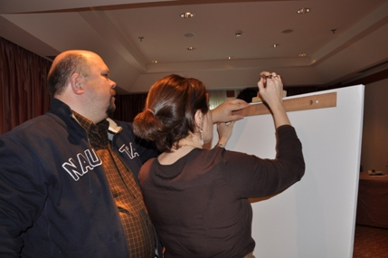
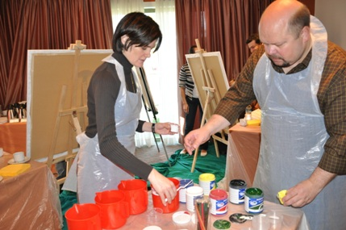
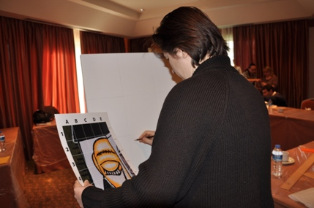
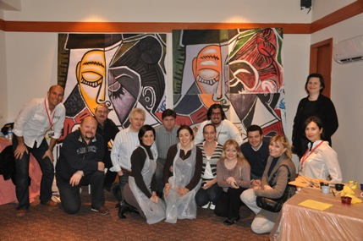
[STAGES OF “THE BIG PICTURE”]
INFORMATION
PLANNING
PAINTING
MATERIALS
DRAWING PHASE
COMBINING
THE COMPONENTS

Slide 5
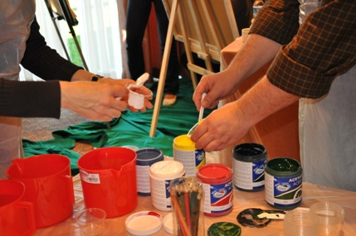
[GETTING ACQUAINTED AND FORMING TEAMS]
Objective;
Heating up and sharing information about the program
Informing about the activity
Getting to know the executive group
Grouping into predetermined teams
Accomodating the participants to the workshop environment

Slide 6
[ASSESSMENT]
Objective
To paint a picture as close as possible to the copy provided The team has to make an assessment and plan where and how to start.
Benefits
Emphasising strategy development
Effective communication
Problem solving
Adapting to the team
Synchronised action
Exchanging ideas
Decision process
Interaction
Different opinions

Slide 7
[PAINTING THE PICTURE]
Objective
After assessment teams start drawing and painting the piece they are responsible from
Benefits
Requires acting together
Requires common solutions
Developing a strategy all together
Emphisises leadership and responsibility
Synchronised action
Sharing ideas
Moving towards a common goal
Interaction
Different opinions

Slide 8
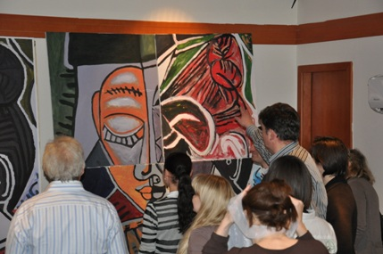
[FINALE]
And…
Meaningless pieces painted on every team’s canvas are brought together at the end of the day and a meaningful whole is formed. The finished pieces are mounted on a giant frame.Mounting takes place behind a curtain. While everybody waits for the results curtains are opened up and the masterpieces are revealed.

Slide 9
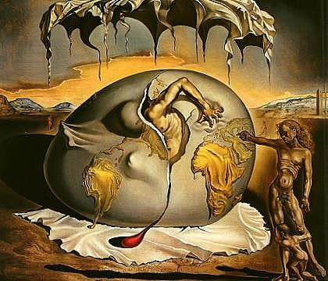
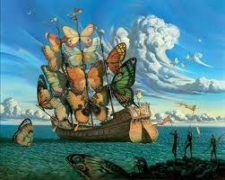
[CHOOSING THE PICTURE]
The picture
Can be inspired by: The image of the company Theme of the conference Objectives and values of the institution Products and services Or a famous piece of art can be enlarged
Teams
The big scale picture is seperated into pieces
Each team is provided with a piece
Each team tries to complete to their best the piece they are responsible from

Slide 10
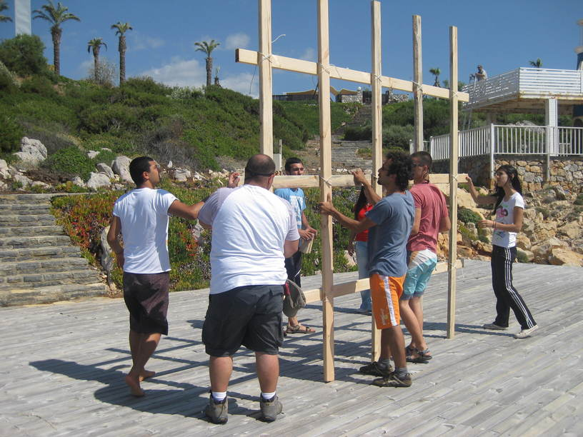
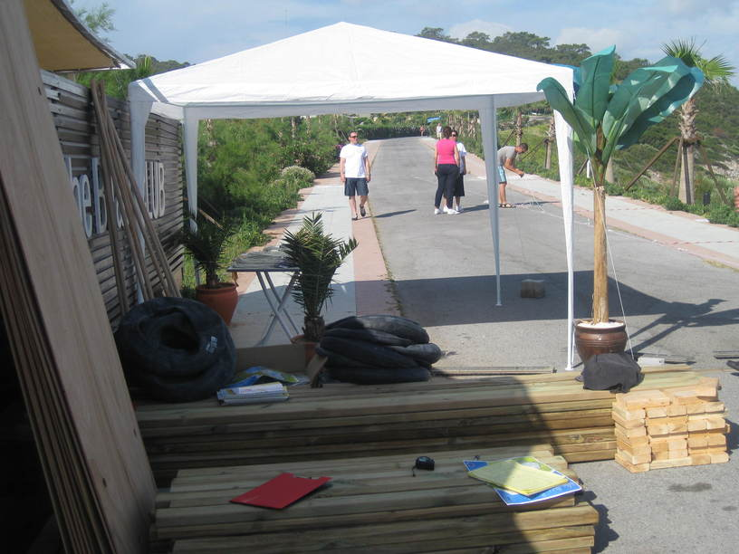
[PREPARATION AND SET-UP]
The set up is completed one day before the event
Activity arae is prepared Assembly stations are marked Required equipment and materials for the teeams are placed in each station Last rehersals are carried out with team managers Last checks are made Final agreements are settled

Slide 11
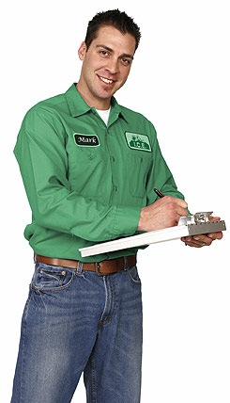
[EXECUTIVE TEAM]
Duties Of The Operation Team
Checking the teams and the time flow, Ensuring a smooth flow of the operation Ministering that the set-up is fully completed
Duties Of The Technical Team
Start setting-up one day before the activity Achieving field set-up Accomplishing cutting up with electric equipment
Duties Of The Activity Managers
Guiding the teams Assuring that the teams’ motivation keeps high Ensuring that the activities run parallel Evaluating the performences of the teams

Slide 12
[GROUPING]
SAMPLE GROUPING FOR EACH PICTURE
PICTURES | PICTURE 1
GROUPS | GROUP A
TEAMS | A1 | A2 | A3 | A4
PAX | 5 | 5 | 5 | 5
TOTAL | 20 MEMBERS

Slide 13
[TIME TABLE]
ACTIVITY STAGES | TIME
ACQUAINTANCE&INFO | 13:00-13:05
FORMING TEAMS | 13:05-13:10
PAINTING | 13:10-15:30
COMBINING THE COMPONENTS | 15:30-15:40
FINALE | 15:45

Slide 14
[COSTING]
Services That Are Included In The Proposal:
Execution of the activities in the program
Services That Are Not Included In The Proposal:
Permisson for the activity area and expenses for such, if required Personnel hosting expenses Transfer of personnel and all transportation expenses Awards and promotional materials, if required Hosting, food and drink expenses of the activity team during the activity working hours The sound system Professional photography and video recording.

Slide 15
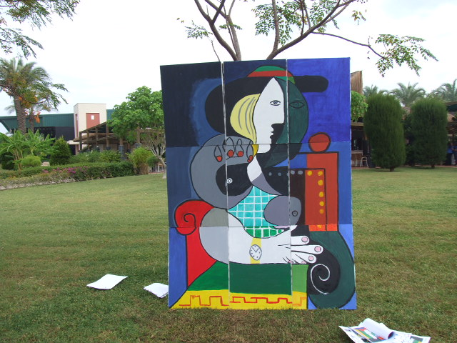
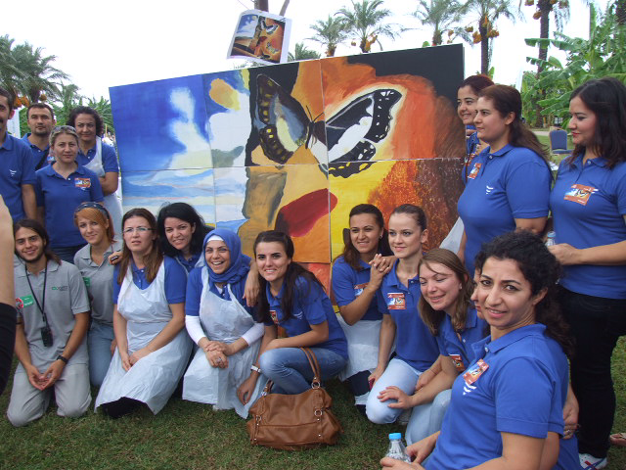
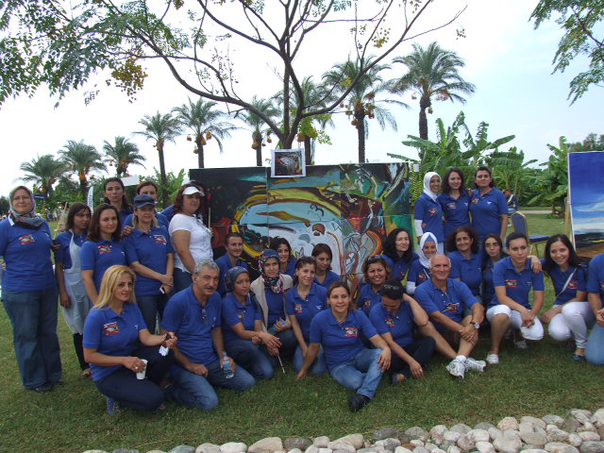
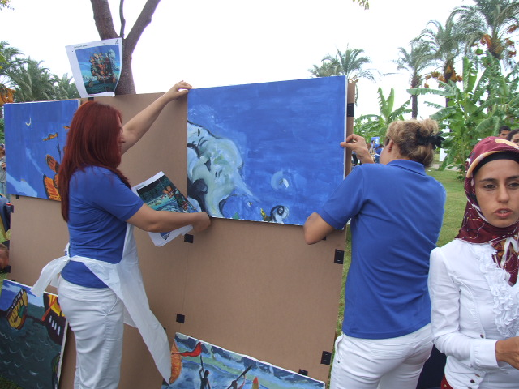
[SAMPLE ACTIVITY PHOTOS]

Slide 16
[GRATITUDE]
THANKS A LOT

