Slide 1
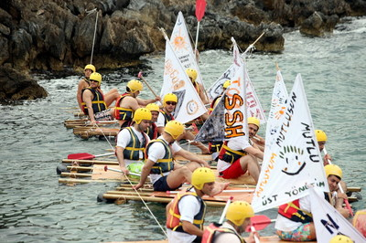
TREASURE ISLAND TEAMWORK ACTIVITY 2015

Slide 2
[FICTION ]
ACTIVITY | Treasure Island
FICTION | The teams initially try to assemble parts of a “raft” following clues, to reach the island where they will have to find the treasure chests. After the “rafts” are built the teams row to the island.
EMPHASIS | Teams composed of employees of the company struggle during the day to reach their goals. The importance of working as a team for the success of the institution is emphasised.

Slide 3
[BENEFITS]
ELEMENTS ASSERTED BY THE “TREASURE ISLAND“
Communication | Interaction | Self managed teams | Developing strategies
Self confidence | Time management | Different opinions | Synergy
Support&harmony | Trust in the team | Empathy | Proactive approach
Active problem solving | Motivation | Setting objectives | Adapting to the team
Outcome orientation | Helping each other | Sharing and responsibility | Leadership

Slide 4
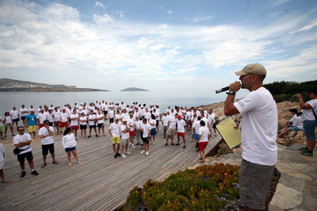
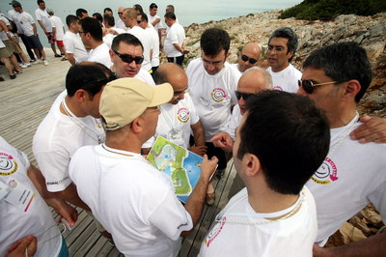
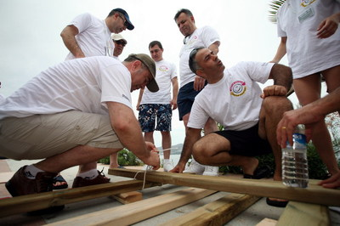
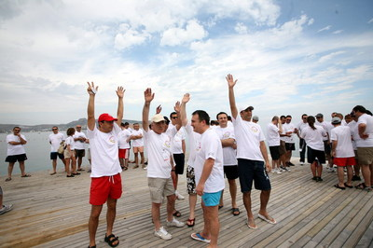
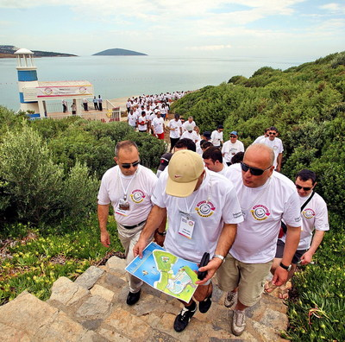
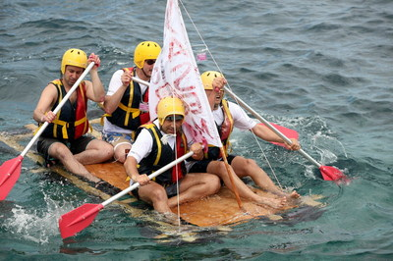
[STAGES OF THE “TREASURE ISLAND” ACTIVITY]
HEATING UP
PLANNING
BUILDING A RAFT
FORMING TEAMS
FINDING THE PIECES
ROWING TO THE ISLAND

Slide 5
[GETTING ACQUAINTED AND FORMING TEAMS]
Objective;
Heating up and sharing information about the program
Informing about the activity
Getting to know the executive group
Grouping into predetermined teams
Accomodating the participants to the workshop environment

Slide 6
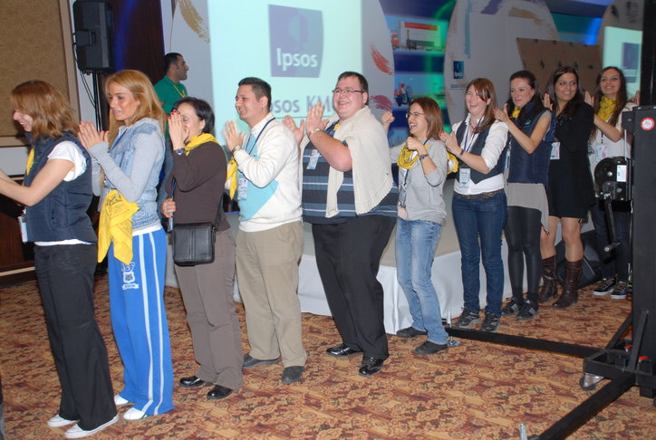
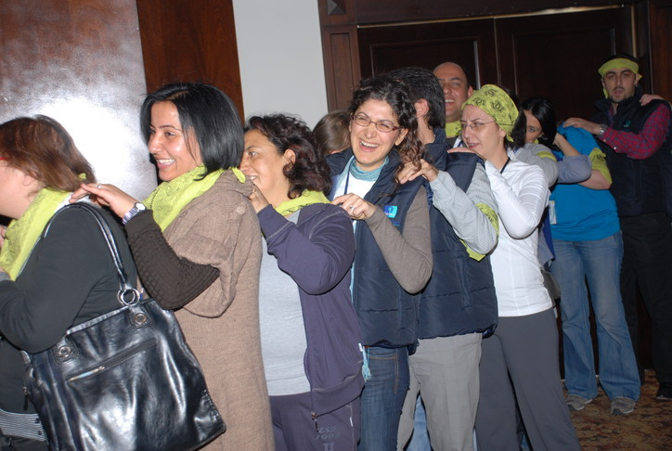
[HEATING UP ]
Massage therapy
Participants form a circle by coming together.Team members systematically massage each other before the activity.
Benefits
Teams getting used to each other
Teams getting used to the activity managers
Teams getting used to the activity environment
Synchronised action
Increased motivation
Interaction and helping each other
Teams getting used to each other

Slide 7
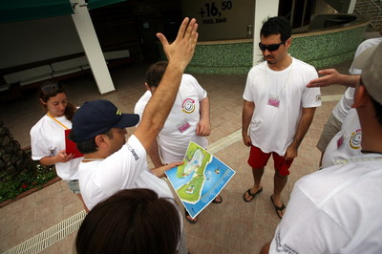
[FINDING THE HIDDEN PIECES]
Objective
Finding pieces of the raft guided by answers to questions, following a map.
Benefits
Using a common resorce
Communication
Problem solving
Active problem solving
Synchronised action
Sharing ideas
The process of decision making
Interaction
Different opinions

Slide 8
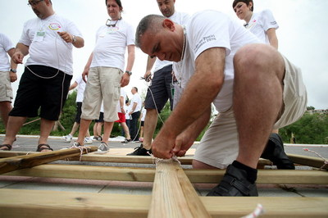
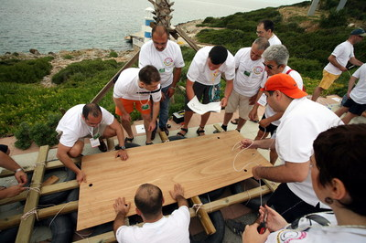
[BUILDING A RAFT]
Objective
Responsibilities are assigned after the needs are assessed.To make best use of the restricted materials at hand, the teams have to calculate wisely
Benefits
Setting objectives
Communication
Problem solving
Active problem solving
Motivation
Sharing ideas
Helping each other
Interaction
Different opinions

Slide 9
[STARTING FOR THE ISLAND]
Objective
Teams try to reach the treasure chests on the island using the rafts they have built
Benefit
Setting objectives
Communication
Team adjustment
Support and motivation
Helping each other
Time management
Self confidance
Interaction

Slide 10
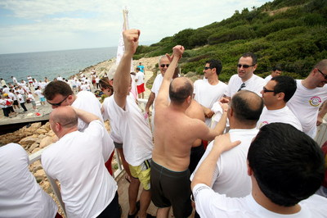
[THE END]
And…
During the day teams compete to make the best time and become first Treasures contained in the chests ( Company logo) are assembled A mosaic is achieved by the effort of all teams Teams which compete with each other during the game but share a common victory at the end The team which brings back the treasure chest first is announced as the winner. Predetermined awards are presented to the successful teams

Slide 11
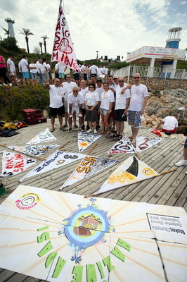
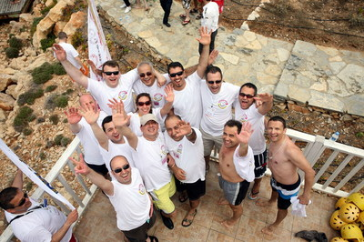
[FINAL]
Finally…
After the presents are given to the most successful team members the program is closed

Slide 12
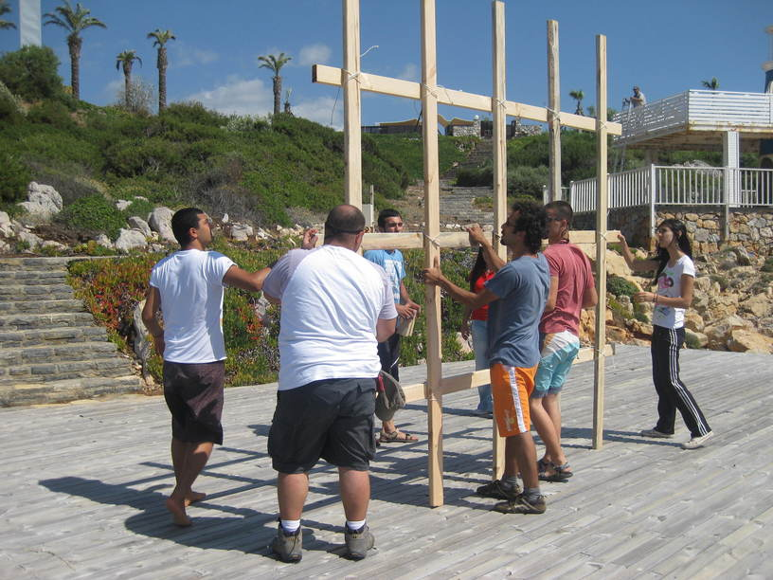
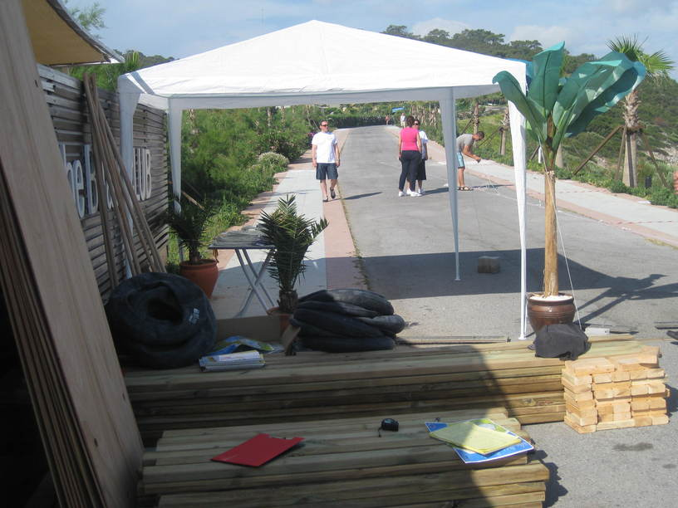
[PREPARATION AND SET-UP]
The set up is completed one day before the event
Activity arae is prepared Assembly stations are marked Required equipment and materials for the teeams are placed in each station Last rehersals are carried out with team managers Last checks are made Final agreements are settled

Slide 13
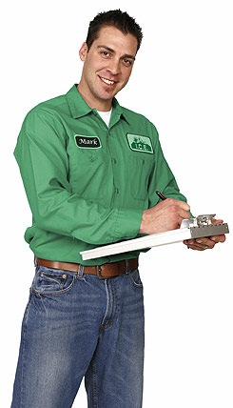
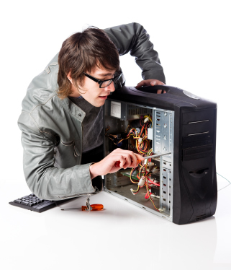
[EXECUTIVE TEAM]
Duties Of The Operation Team
Checking the teams and the time flow, Ensuring a smooth flow of the operation Ministering that the set-up is fully completed
Duties Of The Technical Team
Start setting-up one day before the activity Achieving field set-up Accomplishing cutting up with electric equipment
Duties Of The Activity Managers
Guiding the teams Assuring that the teams’ motivation keeps high Ensuring that the activities run parallel Evaluating the performences of the teams

Slide 14
[TIME TABLE]
ACTIVITY STEPS | ZAMAN
INTRODUCTION &INFO | 13:00-13:10
SEPERATING INTO TEAMS | 13:15-13:20
HEATING | 13:20-13:30
ASSESSMENT | 13:30-13:45
FINDING THE PIECES | 13:45-14:30
BUILDING THE RAFT | 14:30-16:00
STARTING FOR THE TREASURE ISLAND | 16:00-16:30
HAPPY ENDING | 16:30

Slide 15
[COSTING]
Services That Are Included In The Proposal:
Execution of the activities in the program
Services That Are Not Included In The Proposal:
Permisson for the activity area and expenses for such, if required Personnel hosting expenses Transfer of personnel and all transportation expenses Awards and promotional materials, if required Hosting, food and drink expenses of the activity team during the activity working hours The sound system Professional photography and video recording.

Slide 16
[GRATITUDE]
THANKS A LOT

