Slide 1
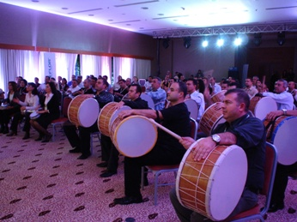
RYTHM WORKSHOP TEAM WORK ACTIVITY 2015

Slide 2
[BENEFITS]
ELEMENTS ASSERTED BY THE “RYTHM WORKSHOP“
Communication | Interaction | Self managed teams | Developing strategies
Self confidence | Time management | Different opinions | Synergy
Support&harmony | Trust in the team | Empathy | Proactive approach
Active problem solving | Motivation | Setting objectives | Adapting to the team
Outcome orientation | Helping each other | Sharing and responsibility | Leadership

Slide 3
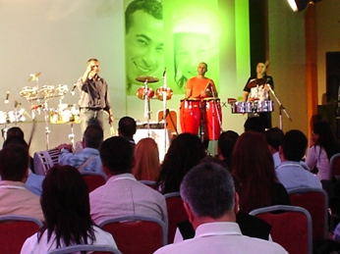
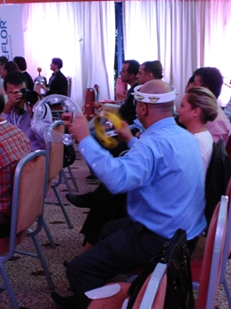
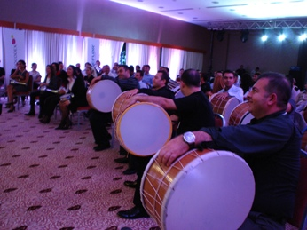
[STAGES OF “RYTHM WORKSHOP”]
GETTING ACQUAINTED AND
HEATING-UP
PRACTICE
AND MUSIC

Slide 4
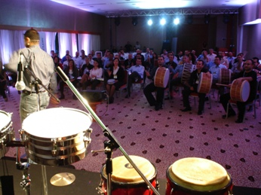
[GETTING ACQUAINTED AND FORMING TEAMS]
Objective;
Heating up and sharing information about the program
Informing about the activity
Getting to know the executive group
Grouping into predetermined teams
Accomodating the participants to the workshop environment

Slide 5
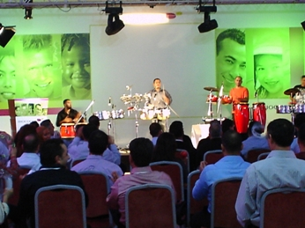
[THEORETICAL EDUCATION]
Objective
Theoretical training is carried out by professional rythm educators. Participants try to accomodate to different instruments. At this stage they are taught to produce the correct sound.
Benefits
Team harmony
Communication
Time management
Active problem solving
Synchronised action
Interaction

Slide 6
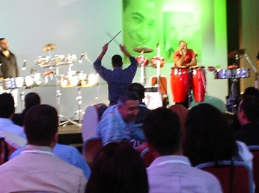
[PRACTICE]
Objective
All ınstrument teams practice simultaneously to produce a common sound. With guidance from their instrustors, team members try to play a given melody at their best,
Benefits
Team harmony
Communication
Time management
Setting objectives
Synchronised action
Interaction

Slide 7
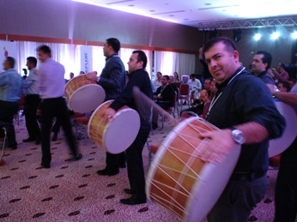
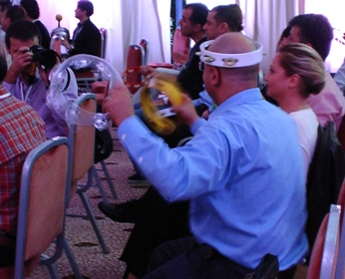
[AND MUSIC]
Objective
After practicing, the teams give their performances. Trainers choose the most successful team
Benefits
Team harmony
Communication
Time management
Setting objectives
Synchronised movements
Interaction

Slide 8
[EXECUTIVE TEAM]
Duties Of The Operation Team
Checking the teams and the time flow, Ensuring a smooth flow of the operation Ministering that the set-up is fully completed
Duties Of The Technical Team
Start setting-up one day before the activity Achieving field set-up Accomplishing cutting up with electric equipment
Duties Of The Activity Managers
Guiding the teams Assuring that the teams’ motivation keeps high Ensuring that the activities run parallel Evaluating the performences of the teams

Slide 9
[TIME TABLE]
ACTIVITY STEPS | TIME
GETTING ACQUAINTED | 16:00
GETTING TO KNOW THE INSTRUMENTS | 16:10
THEORETICAL EDUCATION | 16:15-16:30
PRACTICE | 16:30-17:30
AND MUSIC | 18:00
FINALE | 18:30

Slide 10
[COSTING]
Services That Are Included In The Proposal:
Execution of the activities in the program
Services That Are Not Included In The Proposal:
Permisson for the activity area and expenses for such, if required Personnel hosting expenses Transfer of personnel and all transportation expenses Awards and promotional materials, if required Hosting, food and drink expenses of the activity team during the activity working hours The sound system Professional photography and video recording.

Slide 11
[GRATITUDE]
THANKS A LOT

