Slide 1
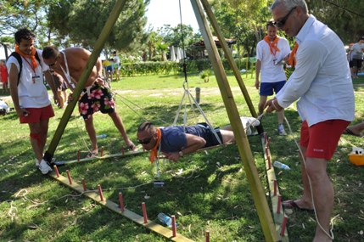
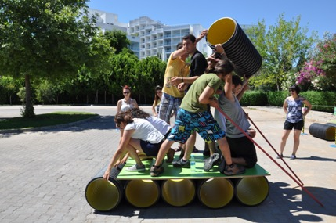
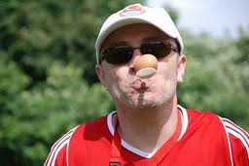
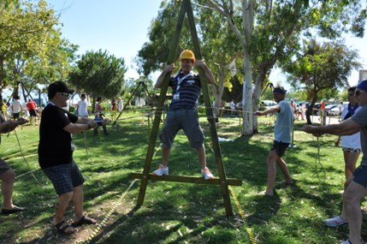
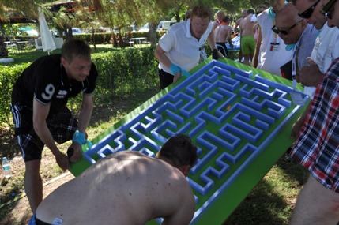
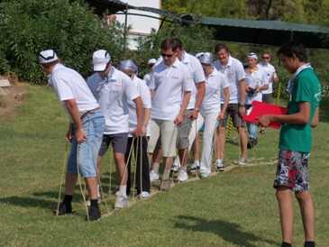
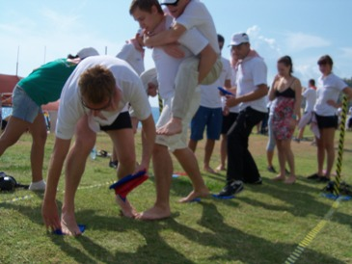
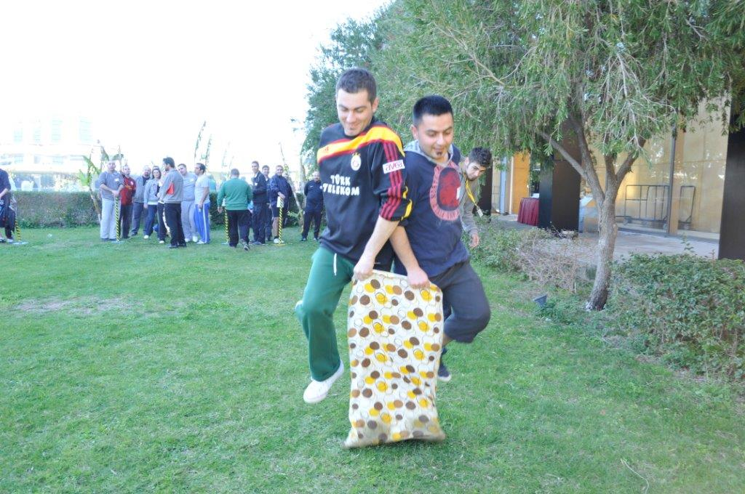
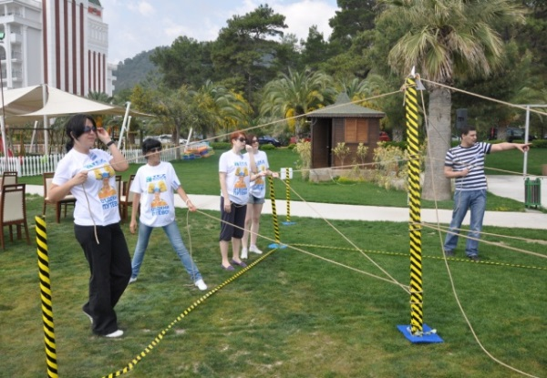
OLYMPIC GAMES
2015

Slide 2
[BENEFITS]
ELEMENTS ASSERTED BY THE “OLYMPIC GAMES“
Communication | Interaction | Self managed teams | Developing strategies
Self confidence | Time management | Different opinions | Synergy
Support&harmony | Trust in the team | Empathy | Proactive approach
Active problem solving | Motivation | Setting objectives | Adapting to the team
Outcome orientation | Helping each other | Sharing and responsibility | Leadership

Slide 3
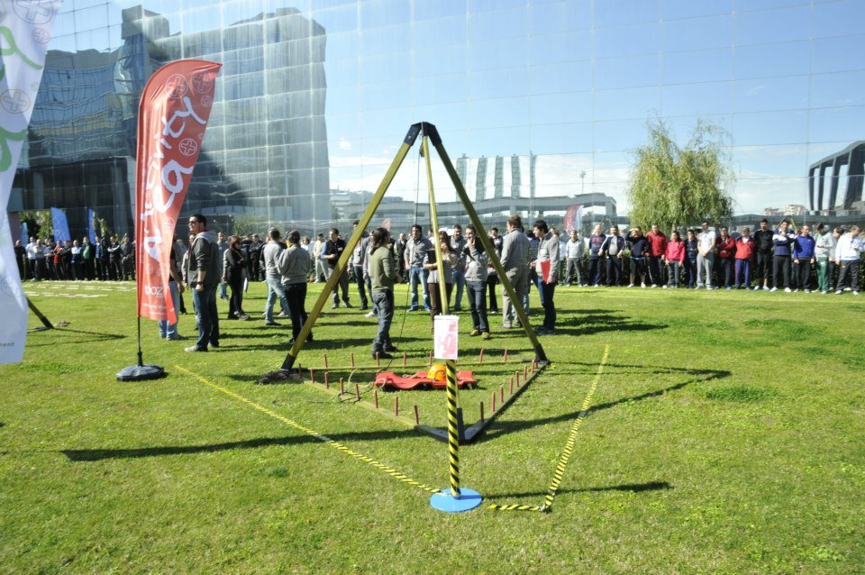
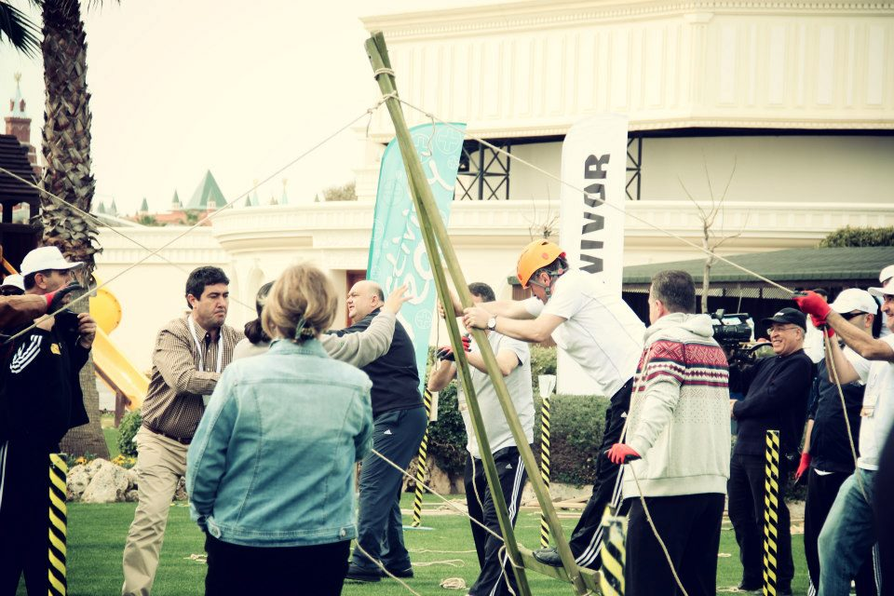
[OLYMPIC GAMES- GAMES SELECTIONS]
THE PYRAMID
THE PUPPET
STONE AGE
THE LYBRINTH

Slide 4
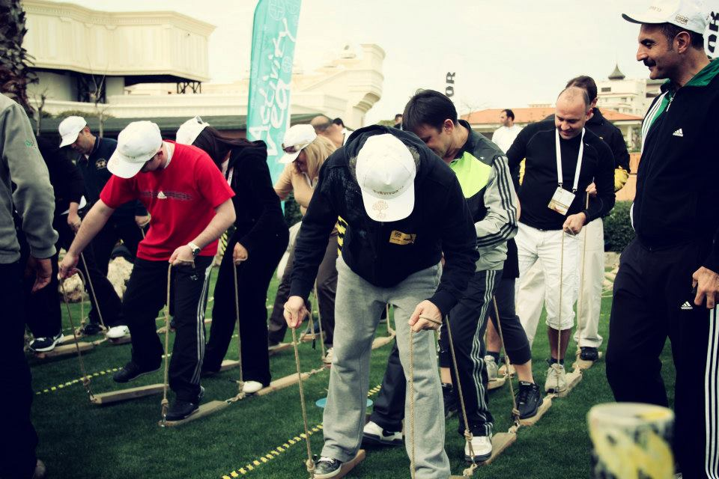
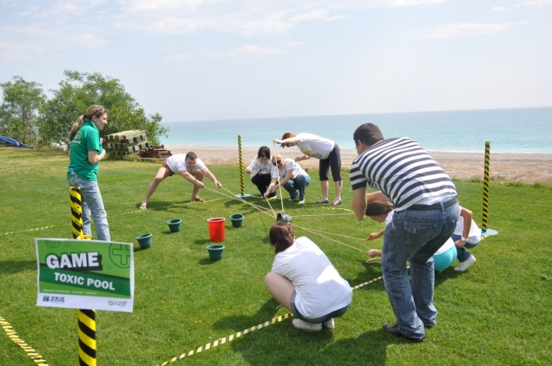
[OLYMPIC GAMES- GAMES SELECTIONS]
THE CATERPILLAR
MAGIC CARPET
POOL ACID
FLAG POST

Slide 5
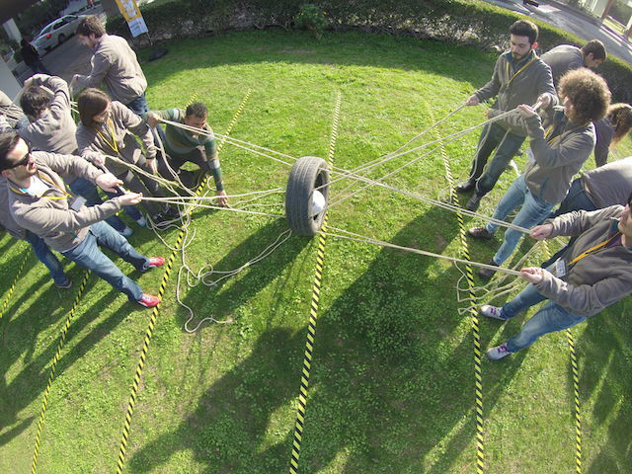
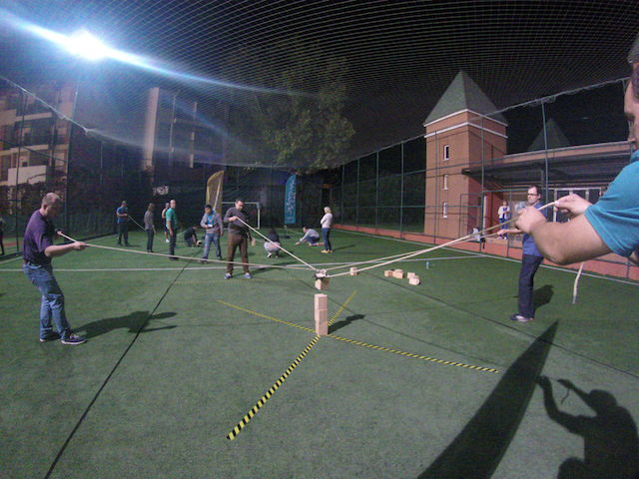
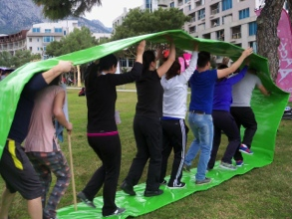
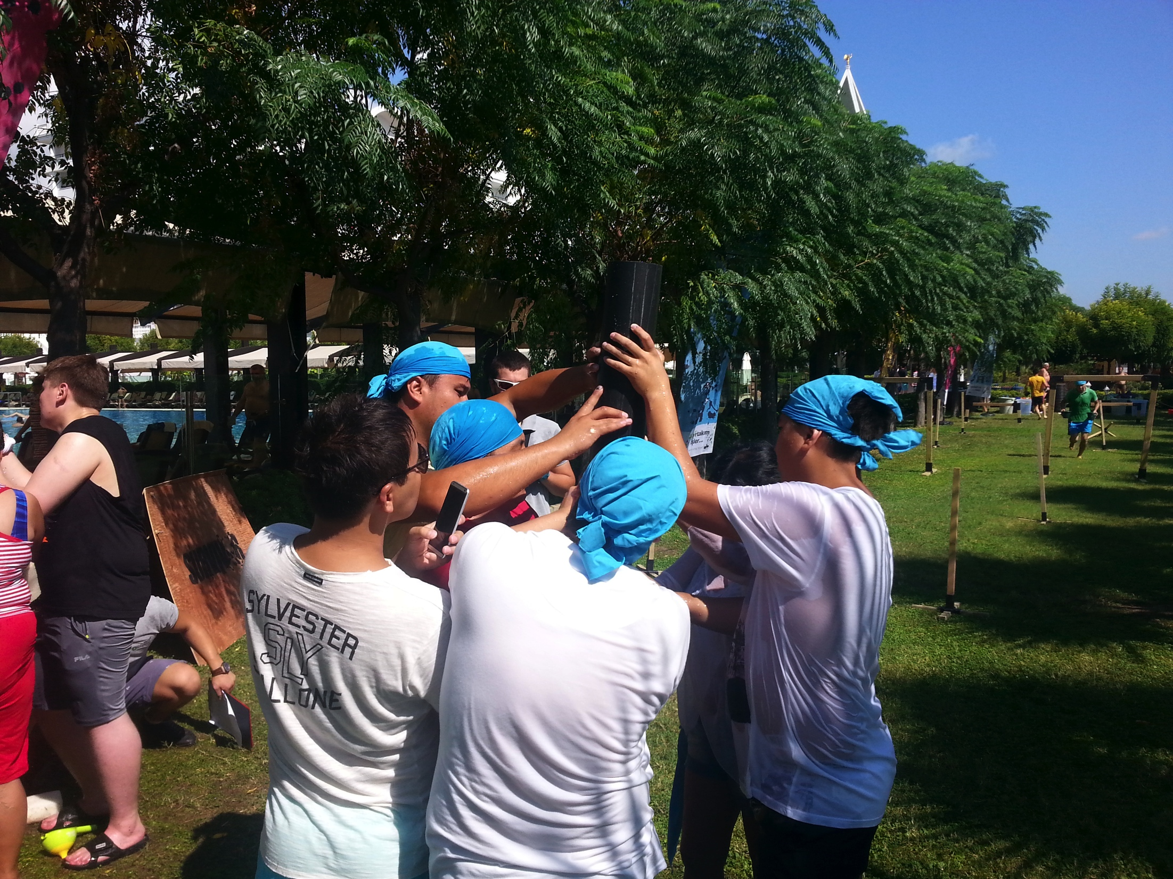
[OLYMPIC GAMES- GAMES OPTIONS]
TIRE BALL
TOWER
SWIVEL
WATER TOWER

Slide 6
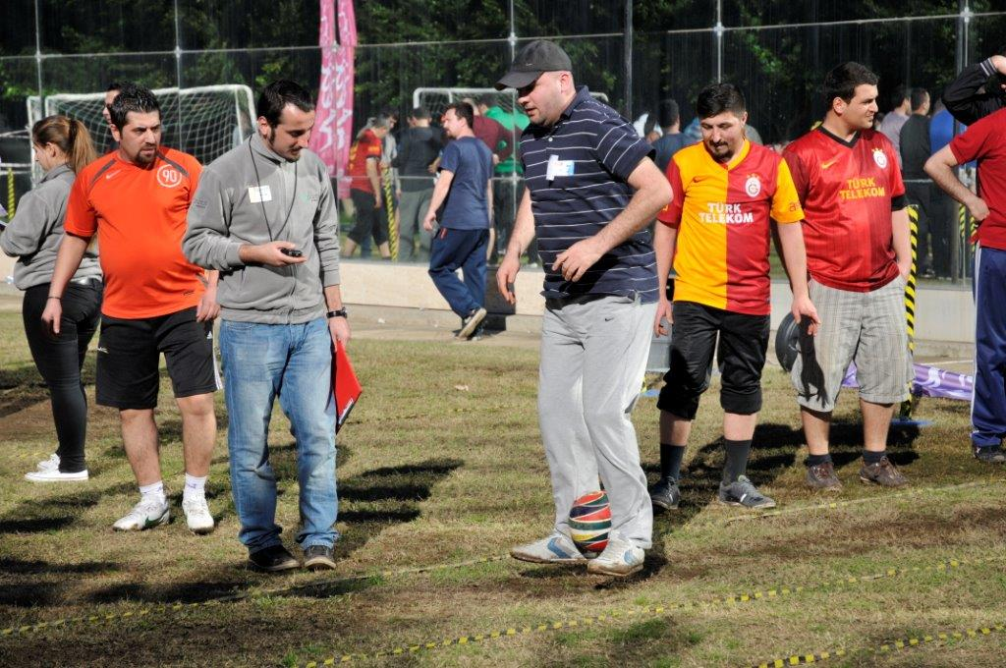
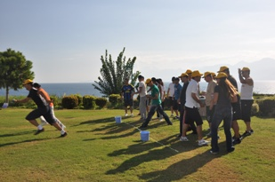
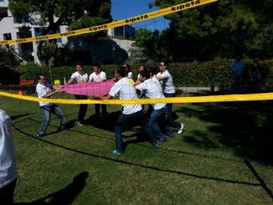
[OLYMPIC GAMES- GAMES OPTIONS]
FOOT&BALL
ONE FOOT
WATER TRANSPORT
CLOTH BALL

Slide 7
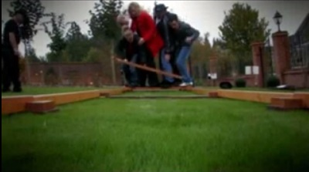
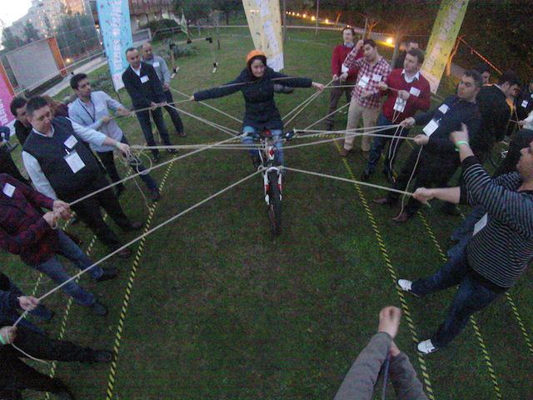
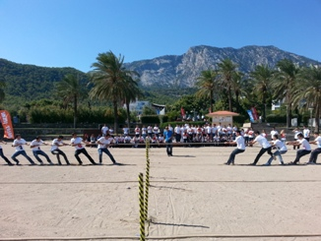
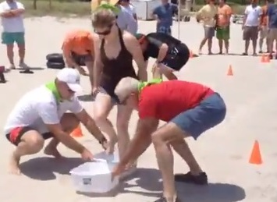
[OLYMPIC GAMES- GAMES OPTIONS]
BALANCE BRIDGE
BALANCE BIKE
TRIATLON
PULLING THE ROOP

Slide 8
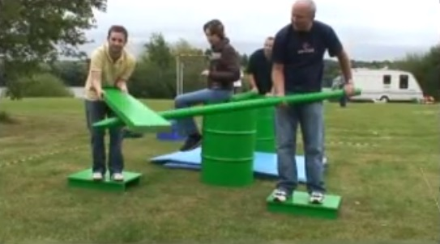
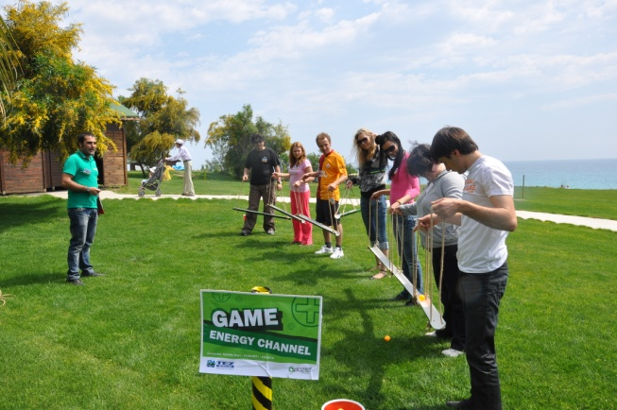
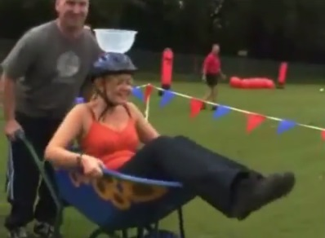
[OLYMPIC GAMES- GAMES OPTIONS]
BRIDGE
BALL TRANSPORT
ENERGY CHANNEL
TAXI

Slide 9
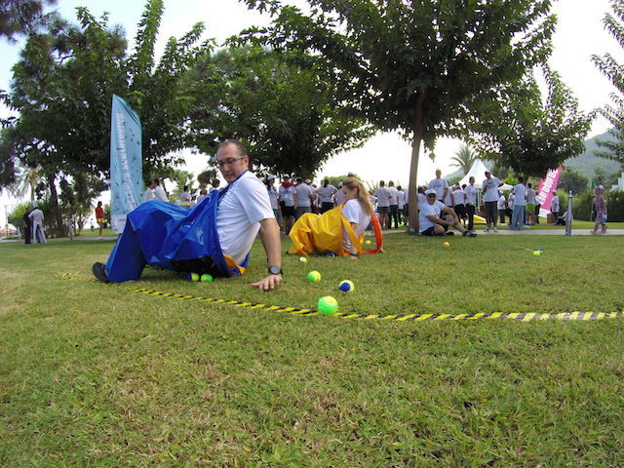
[OLYMPIC GAMES- GAMES OPTIONS]
STICKY PANTS

Slide 10
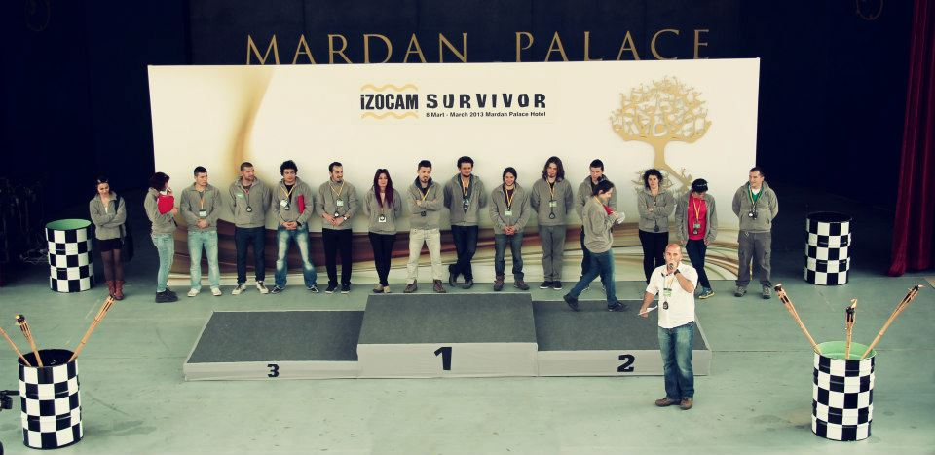
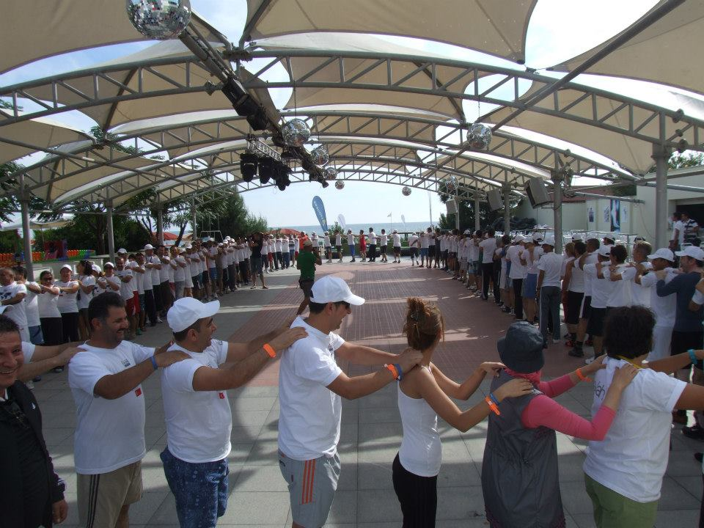
[OLYMPIC GAMES: ACQUAINTED AND HEATING UP]
Objective
Heating up and sharing information about the program
Informing about the activity
Getting to know the executive group
Grouping into predetermined teams
Accomodating the participants to the workshop environment

Slide 11
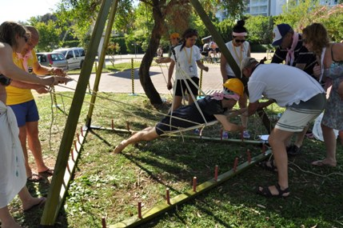
[OLYMPIC GAMES: THE PYRAMID]
Objective
One participant goes inside and changes the places of sticks while the others guide him, to solve the mystery of the pyramid
Benefits
Finding solutions together
Communication
Problem solving
Active problem solving
Synchronised action
Deciding fast
Interaction
Different opinions

Slide 12
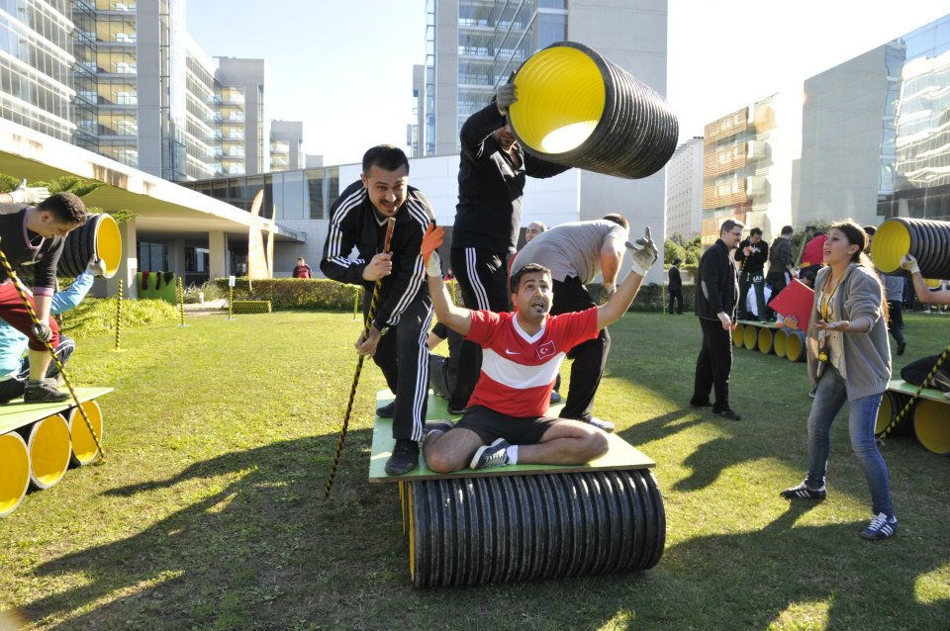
[OLYMPIC GAMES: STONE AGE]
Objective
Travelling with a stone age vehicle as a team and working together for the vehicle to move
Benefits
Finding solutions together
Communication
Problem solving
Active problem solving
Synchronised action
Harmonious and systematic work
Interaction
Helping each other

Slide 13
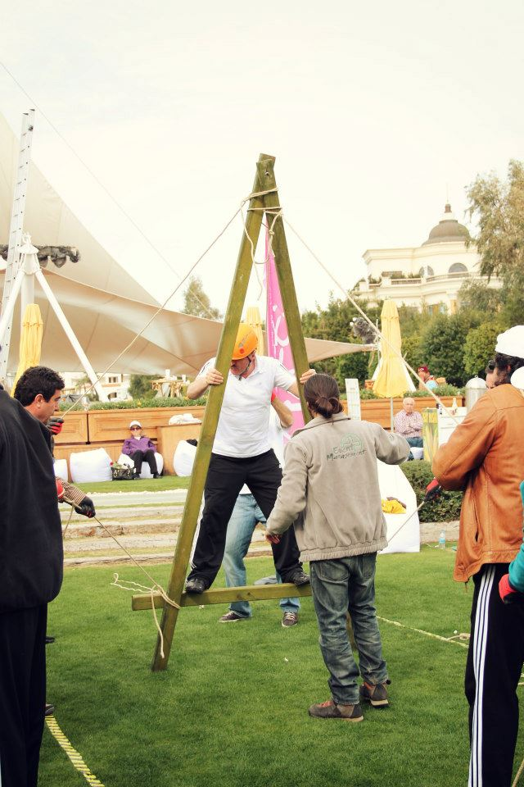
[OLYMPIC GAMES: THE PUPPET]
Objective
The puppet has to be directed towards a target. One member of the team moves the puppet while others control the ropes.
Benefits
Solving problems together,
Communication
Motivation and concentration
Active problem solving
Harmonious and systematic work
Synchronised action
Interaction
Mutual aid

Slide 14
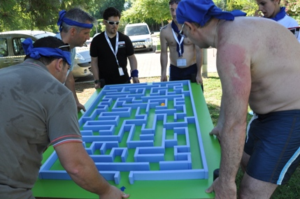
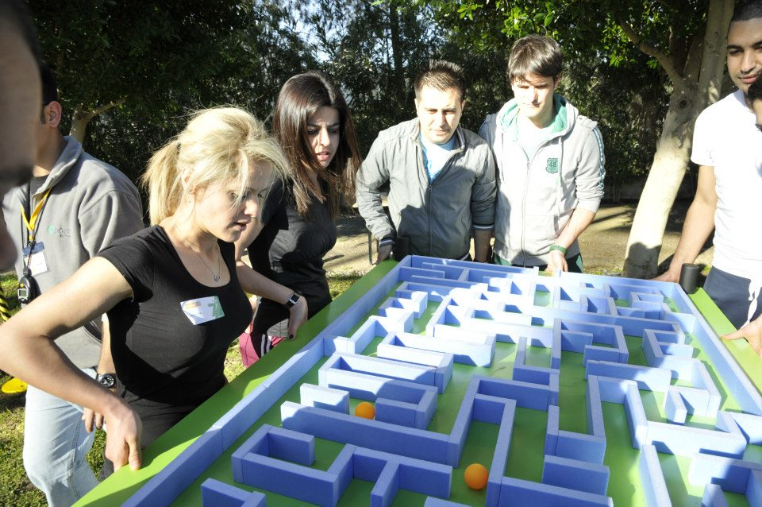
[OLYMPIC GAMES: LYBRINTH]
Objective
Controlling the mobile lybrinth and finding the exit, as a team
Benefits
Solving together,
Communication
Motivation and concentration
Active problem solving
Harmonious and systematic work
Synchronised movement
Interaction
Mutual aid

Slide 15
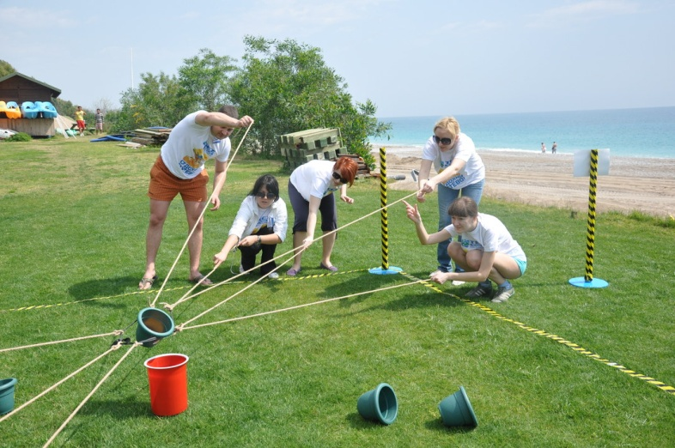
[OLYMPIC GAMES: ACID POOL]
Objective
Placing the information balls into the correct resources without falling in the acid pool. It is exactly a team effort. Every team should first solve the problem in coordination. It is then very important to be able to realise the theoretical solution.
Benefits
Solving together
Communication
Motivation and concentration
Active problem solving
Synchronised movement
Interaction

Slide 16
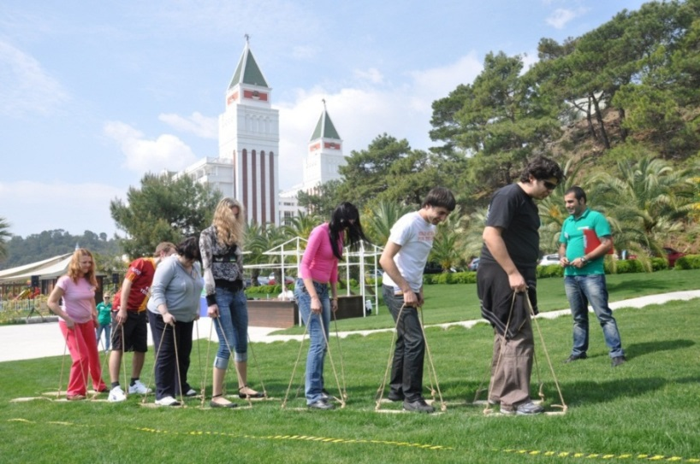
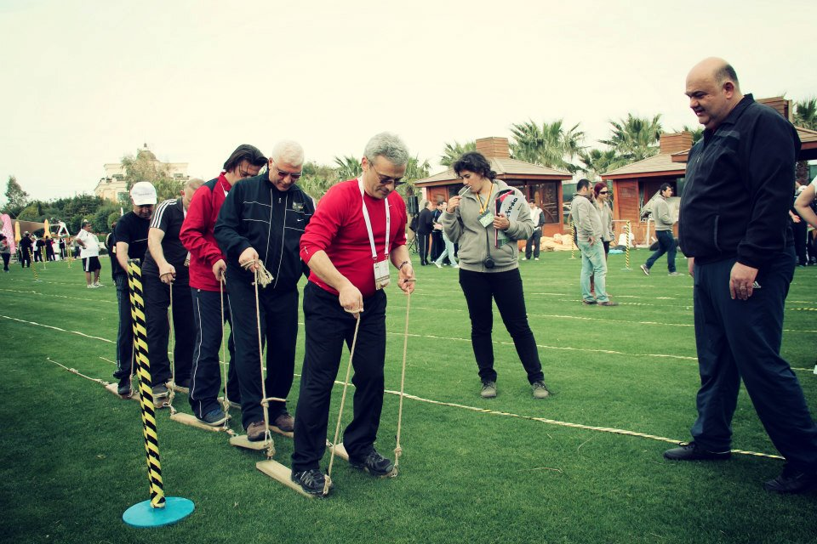
[OLYMPIC GAMES: THE CATERPILLAR ]
Objective
Being able to move towards a target as a team. An activity which seems easy but can not be achived even if one member fails to move in synchrony.
Benefits
Moving as a team
Motivation and concentration
Communication
Synchronised movement
Harmonised and systematic work
Communication
Leadership

Slide 17
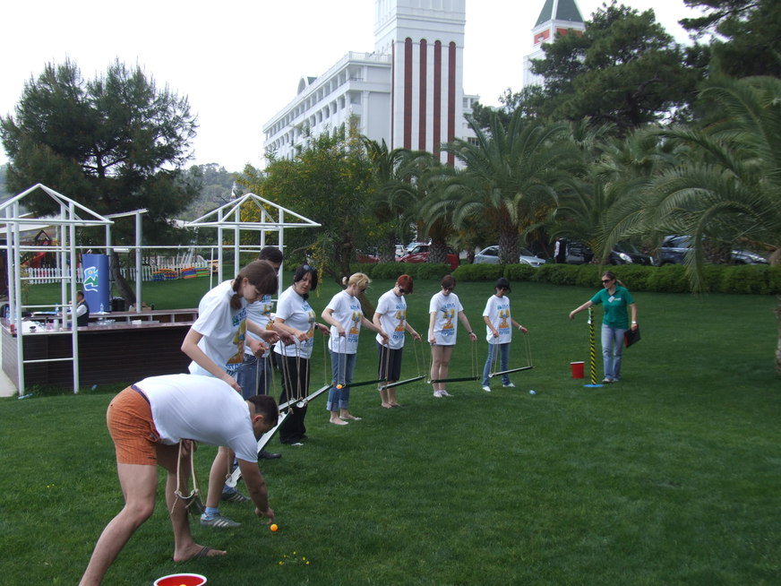
[OLYMPIC GAMES: THE ENERGY CHANNEL]
Objective
Move energy balls over the energy lines. An activity where intercommunication competence comes forward and coordinated action is essential
Benefits
Finding solutions together
Developing srrategies
Motivation and concentration
Communication
Synchronised movement
Harmonious and systematic work
Interaction
Mutual aid

Slide 18
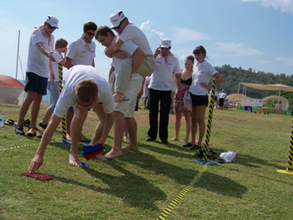
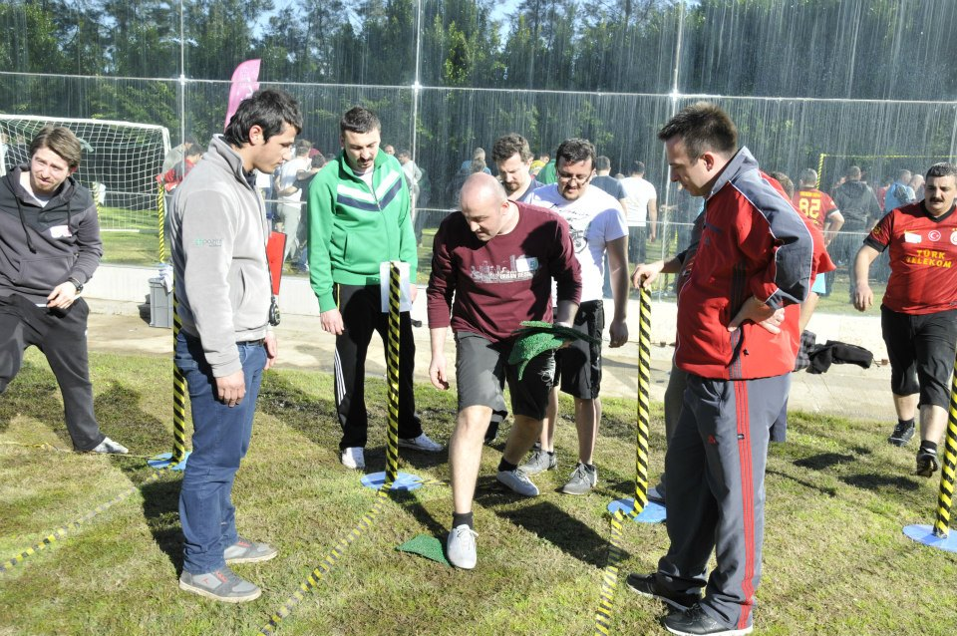
[OLYMPIC GAMES: MAGIC CARPET]
Objective
To carry the healing waters without spilling across the pool using the magic carpets. A complete support activity with team members joining hands
Benefits
Finding solutions together
Communication
Motivation and concentration
Trust and support
Synchronised movement
Harmonised and systematic work
Interaction
Mutual aid

Slide 19
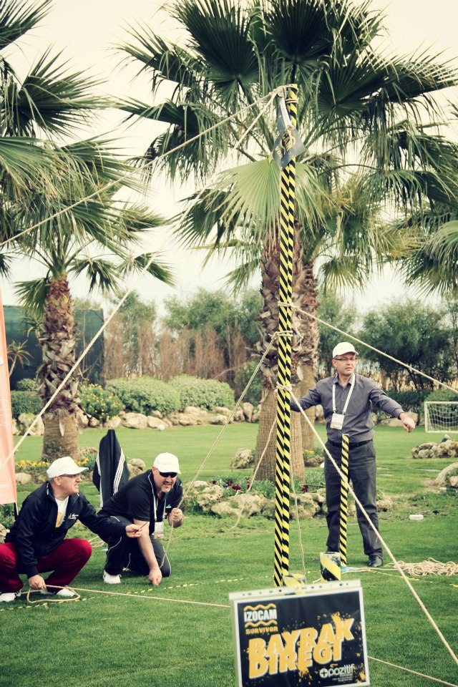
[OLYMPIC GAMES: FLAG POLE]
Objective
Mounting the “Institutional flag” at the secure place A fun game to play which ensures unity with the Brand by mounting the company flag.
Benefits
Finding solutions and strategies together
Communication
Motivation and communication
Active problem solving
Synchronised movement
Harmonised and systematic work
Leadership and responsibility
Moving towards a common goal

Slide 20
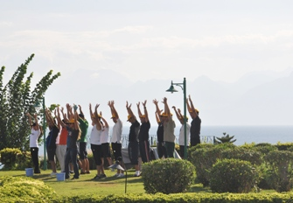
[OLYMPIC GAMES: WATER TRANSPORT]
Objective
Each team, the water in the bucket, sponges to fill the empty bucket with carry and with the maximum amount of work possible Competition, team cohesion, and time management elements such as foreground extraction activity
Faydalar
Together solutions and strategy development,
Communications
Motivation and concentrate
Effective problem-solving
A sense of leadership and responsibility
To be moved to a common destination

Slide 21
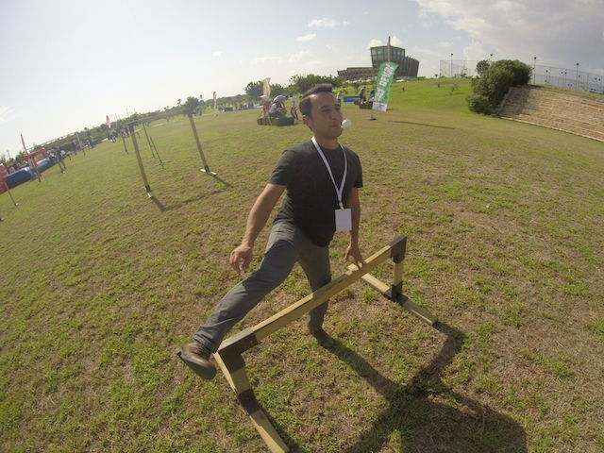
[OLYMPIC GAMES: BALL TRANSPORT]
Amaç
We're moving to the target with the help of wooden spoons plastic balls. Lower who can carry the ball more than most team wins the competition.
Benefit
To act as a team
Motivation and consantrate
Communication
Synchronizing
Compatible and systematic work
Influence

Slide 22
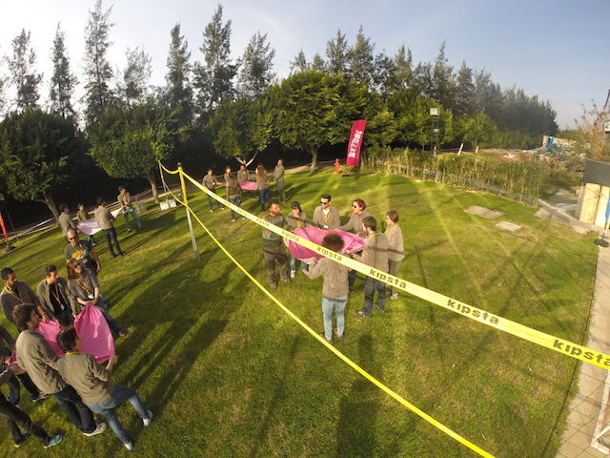
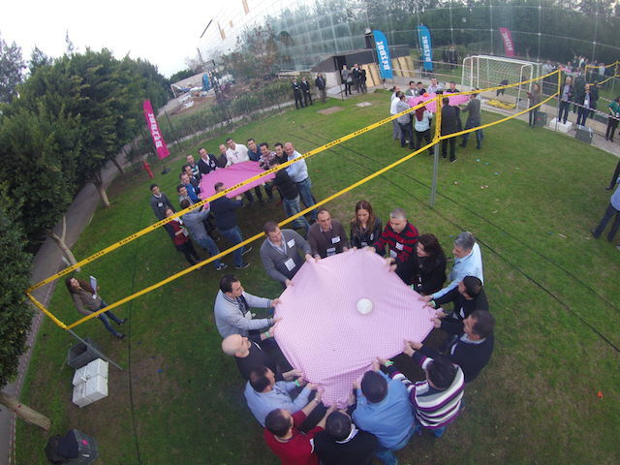
[OLYMPIC GAMES: CLOTH BALL]
Objective
Teams play voleyball with water balloons by cloth
Benefits
Finding solutions and strategies together
Communication
Motivation and communication
Active problem solving
Synchronised movement
Harmonised and systematic work

Slide 23
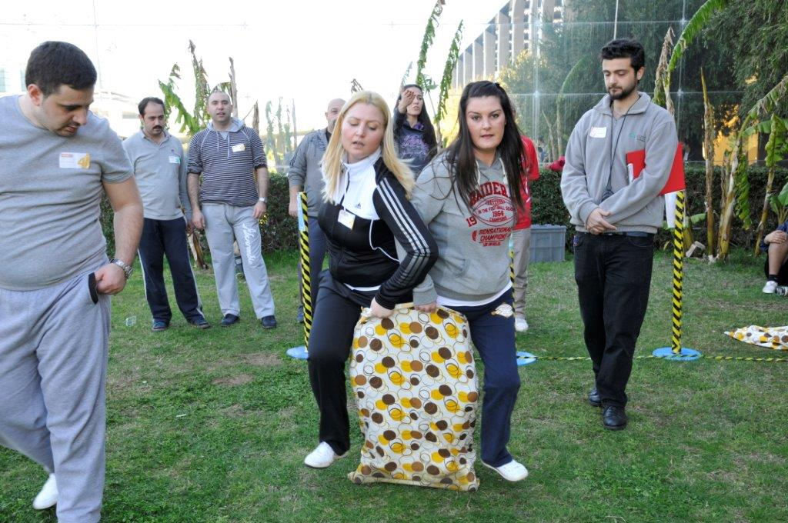
[OLYMPIC GAMES: ONE FOOT]
Objective
Only used one foot sack race, but there are two competititors in the sack.
Benefits
Finding solutions and strategies together
Communication
Motivation and communication
Active problem solving
Synchronised movement
Harmonised and systematic work

Slide 24
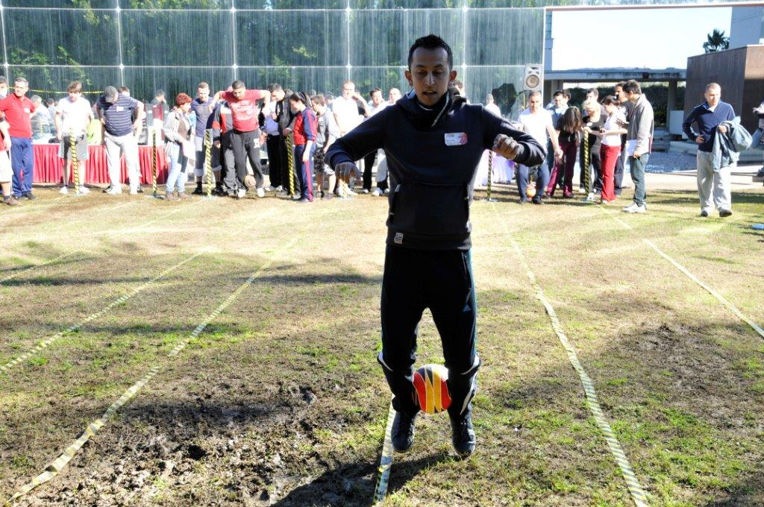
[OLYMPIC GAMES: FOOT&BALL]
Objective
In accordance with the rules, all the team members, as well as tries to deliver the ball to the specified destination in the shortest time.
Benefit
To act as a team
Emphasize the importance of team cohesion
Communication
Synchronizing
Compatible and systematic work
To act together requires

Slide 25
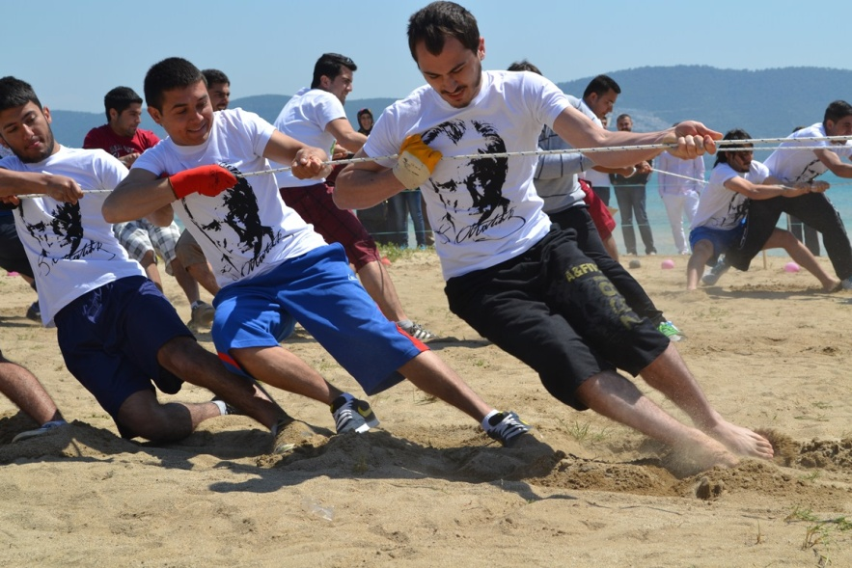
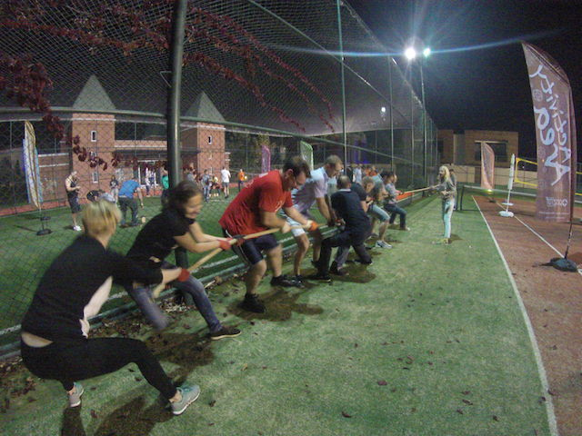
[OLYMPIC GAMES: PULLING THE ROPE]
Objective
Teams compete on both ends of a rope, mutually. Being the most powerful isn't always enough, it is necessary to apply the best tactic.
Benefit
Finding solutions and strategies together
Communication
Motivation and communication
Active problem solving
Synchronised movement
Harmonised and systematic work

Slide 26
[OLYMPIC GAMES: THE BRIDGE]
Objective
We have a track filled with obstacles that team members are pending. Prevents team members from separating from each other is filled with this track are required by building bridges to overcome soon. While negotiating obstacles, without losing any of the materials restricted in their hands, must be according to the rules.
Benefit
Problem solving
Quick decision making
Support and motivation
Synchronizing
Influence
Strategy

Slide 27
[OLYMPIC GAMES: TAXI]
Objective
Taxi to a combination of fun and challenge activity will work. Team members are, respectively, the taxi driver and taxi passengers. There are tasks that must be completed over the course of the cab. Each team the task team which carry out certain tasks that will deliver the capabilities of team members in the decision which would be impressive.
Benefit
To act as a team
Communication
Synchronizing
Harmonised and systematic work
To act together requires

Slide 28
[OLYMPIC GAMES: TIRE BALL]
Objective
The ball rubber ball in the activity, they try to engage you from start to the end of the track teams. While doing this, the ball must not touch the ground. They try to do this operation with the help of ropes and tires. The ropes move the ball quickly to each other that we put into the tire before wheeling. Pleasant an activity that requires coordination and attention.
Benefit
Finding solutions and strategies together
Communication
Motivation and communication
Active problem solving
Synchronised movement

Slide 29
[OLYMPIC GAMES: TOWER]
Objective
Teams are asked to build a tower. To do this, use the materials given and never needs touching up parts of the tower. Challenging boundaries, to be calm is a fun that requires team-work activity.
Benefits
Finding solutions and strategies together
Communication
Motivation and communication
Active problem solving
Synchronised movement

Slide 30
[OLYMPIC GAMES: SWIVEL]
Objective
Exciting head-to-head battle, are you ready? Hoop teams into the assembly by acting in a coordinated manner with all the other teams compete. The mechanism must be able to move in at the same time to return.
Benefit
Finding solutions and strategies together
Communication
Motivation and communication
Active problem solving
Finding solutions and strategies together
Communication

Slide 31
[OLYMPIC GAMES: BALANCE BIKE]
Objective
How many people can use a bike? Balance bike with a whole team... A participant rides a bike, but it just sits in the bin. The rope connecting with other participants from various parts of the bike with the bike to try to keep balance. Reasons well his teammates must be coordinated. Then, the specified distance in a coordinated way with the help of his teammates the ropes again try to complete without dropping the bike.
Benefit
Produce solutions together
Communication
Motivation and Consantrate
Synchronizing

Slide 32
[OLYMPIC GAMES: TRIATLON]
Objective
Presented in 3 different game from each other a single activity of delightful, enjoyable, challenging work. In this study, such as walking and trolley with the bucket in the sack race team exercises we have included our friend so much fun to drive. Teams they work as a team to complete all the parts in the shortest possible time.
Benefit
To act as a team
Motivation and Consantrate
Communication
Synchronizing
Interaction
Leader

Slide 33
[OLYMPIC GAMES: BALANCE BRIDGE]
Objective
On the steps of completing the transition to the bridge, a suspension bridge as a team we are working on. The number of digits to complete the bridge but it's not enough. You need to move forward to advance the previous steps continuously. Getting support from each other as a team is very important if we are to advance on the bridge.
Benefit
To act as a team
Motivation and consantrate
Communication
Synchronizing
Interaction
Leader

Slide 34
[OLYMPIC GAMES: WATER TOWER]
Objective
The aqueous tower your goal in the game is to bring the ball inside to the outside of the tower. This will not be as easy as it sounds. Because it is forbidden to take the ball out. The only way to make the ball rise and fill up with water tower. We fill the holes on the tower, the water is evacuated because the water filling holes in the team when we need to close. Reaching into the water isn't easy, bring water, close the holes, fun activity and a wet
Benefit
Motivation and Consantrate
Communication
Intraction
Leader

Slide 35
[OLYMPIC GAMES: STICKY PANTS]
Objective
The pants will be able to collect the ball with adhesive? With adhesive tape in the back of his trousers before competitors see if we can get the ball. Have fun with this activity and will embrace the competition.
Benefit
Motivation and Consantrate
Communication
Intraction
Timing

Slide 36
[TIME TABLE]
STAGES | TIME
ACQUAINTANCE&INFO | 14:30 -14:45
1. STAGE GAMES | 15:00 -15:15
2. STAGE GAMES | 15:20 -15:35
3. STAGE GAMES | 15:40 -15:55
4. STAGE GAMES | 16:05 -16:20
5. STAGE GAMES | 16:25 -16:30
6. STAGE GAMES | 16:40-17:00
FINALE | 17:30

Slide 37
[TEAM AND ROTATION]
ROTATION
Within each color group process. Each team in its own right that resides in the colour group with the teams struggles. As mentioned in the program set each game takes 15 minutes. A break of 5 minutes after each game are given. All games starts and ends simultaneously. After the break that between games, teams move to next game station. All teams attend all the games at he end of the day.

Slide 38
[TEAM AND ROTATION]
Rotation
There is a rotation of the sample in the adjacent figure. Each game takes 15 minutes. The teams after each game goes to the next game. All teams begin competition at the same time and finish at the same time.
A GAME STATION
C GAME STATION
D GAME STATION
E GAME STATION
F GAME STATION
B GAME STATION

Slide 39
[PREPARATION AND SET-UP]
The set up is completed one day before the event
Activity arae is prepared Assembly stations are marked Required equipment and materials for the teeams are placed in each station Last rehersals are carried out with team managers Last checks are made Final agreements are settled

Slide 40
[EXECUTIVE TEAM]
Duties Of The Operation Team
Checking the teams and the time flow, Ensuring a smooth flow of the operation Ministering that the set-up is fully completed
Duties Of The Technical Team
Start setting-up one day before the activity Achieving field set-up Accomplishing cutting up with electric equipment
Duties Of The Activity Managers
Guiding the teams Assuring that the teams’ motivation keeps high Ensuring that the activities run parallel Evaluating the performences of the teams

Slide 41
[COSTING]
Services That Are Included In The Proposal:
Execution of the activities in the program
Services That Are Not Included In The Proposal:
Permisson for the activity area and expenses for such, if required Personnel hosting expenses Transfer of personnel and all transportation expenses Awards and promotional materials, if required Hosting, food and drink expenses of the activity team during the activity working hours The sound system Professional photography and video recording.

Slide 42
[GRATITUDE]
THANKS A LOT

