Slide 1
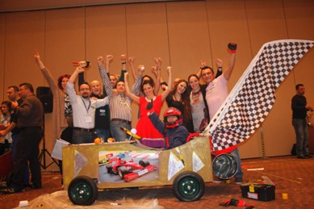
THE GREAT RACE TEAMWORK ACTIVITY 2015

Slide 2
[FICTION ]
FICTION | Teams build a vehicle as defined by the project. At the end of the race teams are appraised in the categories of: Best desing Best performance Best service time
EMPHASIS | Teams made up of the units within the company compete during the day to be the best. As the teams compete with each other in the technical categories of design, performance and service the technology sector is recalled. The significance of working as a team to achieve the success of the institution is emphasised.

Slide 3
[BENEFITS]
ELEMENTS ASSERTED BY THE “THE GREAT RACE“
Communication | Interaction | Self managed teams | Developing strategies
Self confidence | Time management | Different opinions | Synergy
Support&harmony | Trust in the team | Empathy | Proactive approach
Active problem solving | Motivation | Setting objectives | Adapting to the team
Outcome orientation | Helping each other | Sharing and responsibility | Leadership

Slide 4
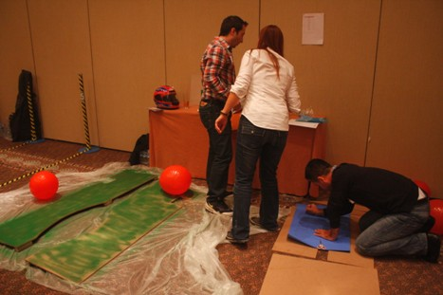
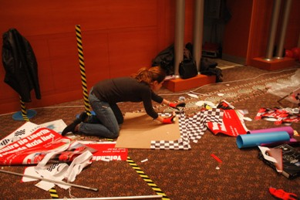
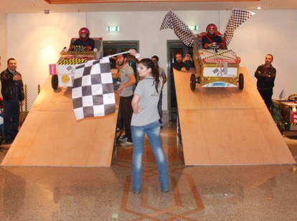
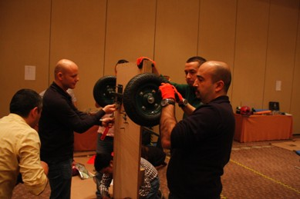
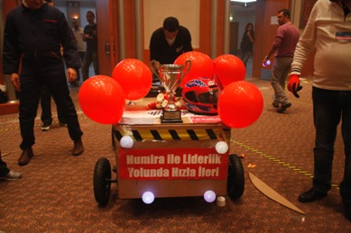
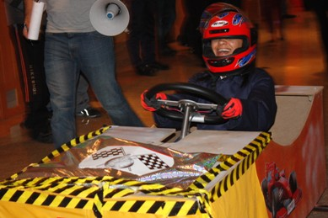
[STAGES OF “THE GREAT RACE”]
THE PIECES
VISUALS
RACE
ASSEMBLY
BEST DESIGN
PERFORMANCE

Slide 5
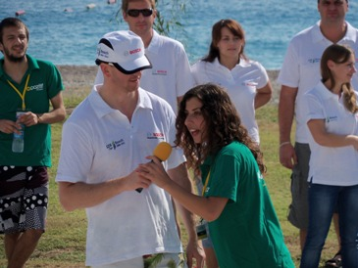
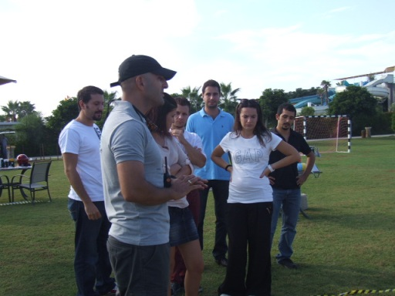
[GETTING ACQUAINTED AND FORMING TEAMS]
Objective;
Heating up and sharing information about the program
Informing about the activity
Getting to know the executive group
Grouping into predetermined teams
Accomodating the participants to the workshop environment

Slide 6
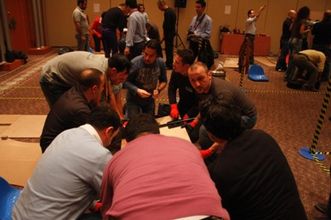
[PROJECT ASSESSMENT]
Objective
To assess the project and form a strategy Designing the ideal bridge using the materials provided.. To work in close collaboration with other teams to complete the bridge from sections made by each team. Moving parallel all together towards the common objective.
Benefit
Common resource use
Communication
Problem solving
Synchronised action
Sharing ideas
The decision process
Etkileşim

Slide 7
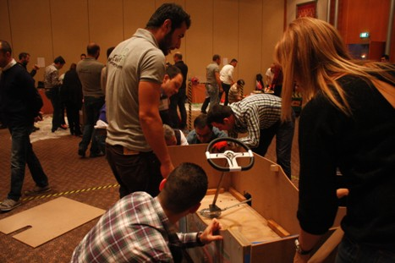
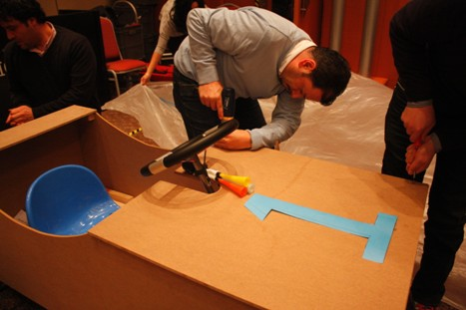
[INSTALLATION-SETUP]
Objective
Once needs are identified, the distribution of tasks is made. The teams have to make accurate calculations to make best use of the available bridge materials Teams have to consider that the bridge has to be strong, stable and wide enough for a test drive by a remote controlled vehicle.
Benefits
Common resource use
Communication
Problem solving
Synchronised action
Self managing teams
Decision process
Interaction

Slide 8
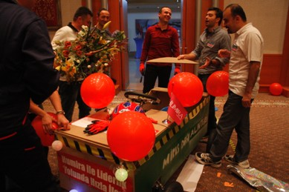
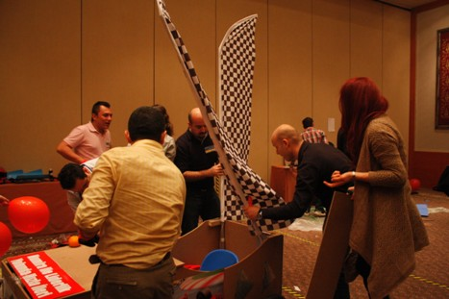
[VISUALS]
Objective
The bridge imagined by the teams is given life with creativeness With imagination,teams try to make the best designs of bridge parts by using a limited amount of material Teams will enjoy their work while brand name and teamwork is stressed at the same time
Benefits
Creativeness
Communication
Stressing the barnd name
Forming concepts
Synergy
Development of the team spirit
Interaction

Slide 9
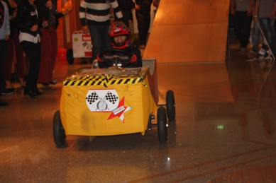
[RACE 1: BEST PERFORMANCE]
Objective
Teams race with the race cars they have built. Cars are rolled down a slope and the car that goes furthest eliminates the others
Benefits
Team harmony
Motivation and team support
Time management
Helping each other
Responsibility and ownership
Synergy

Slide 10
[RACE 2: BEST DESING]
Objective
The jury selects the best designed race car. Teams force the limits of creation in the activity where interesting designs are produced
Benefits
Team harmony
Motivation nad team support
Helping each other
Time management
Responsibility and ownership
Synergy

Slide 11
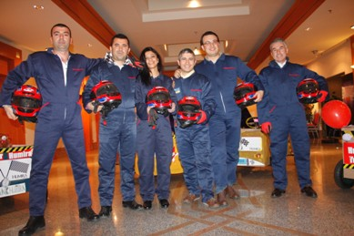
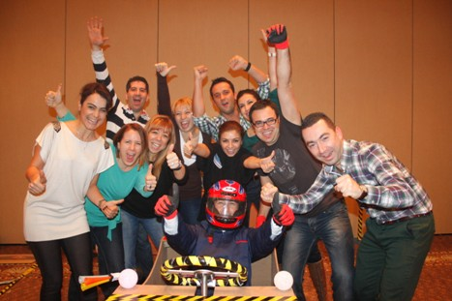
[RACE 3: THE BEST TIME FOR THE PIT STOP]
Objective
Teams perform general maintanace and tire change during the race. The team which has the shortest pit-stop gains an advantage in the race.
Benefits
Team harmony
Motivation and team support
Helping each other
Time management
Resposibility and ownership
Synergy

Slide 12
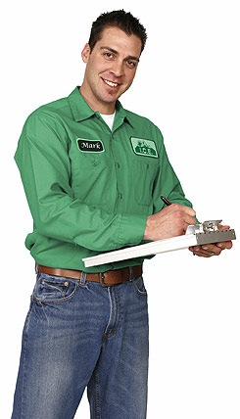
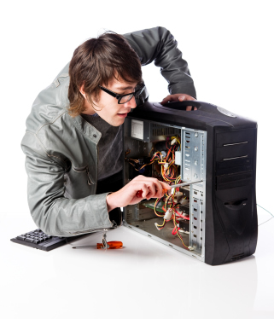
[EXECUTIVE TEAM]
Duties Of The Operation Team
Checking the teams and the time flow, Ensuring a smooth flow of the operation Ministering that the set-up is fully completed
Duties Of The Technical Team
Start setting-up one day before the activity Achieving field set-up Accomplishing cutting up with electric equipment
Duties Of The Activity Managers
Guiding the teams Assuring that the teams’ motivation keeps high Ensuring that the activities run parallel Evaluating the performences of the teams

Slide 13
[TIME TABLE]
ACTIVITYSTEPS | TIME
ACQUAINTANCE&INFO | 13:30-13:45
PROJECT ASSESSMENT | 13:45-14:00
ASSEMBLY | 14:00-15:00
IMAGINATION AND DESIGN | 15:00-15:30
DESING RACE | 15:30-16:00
PERFORMANCE RACE | 16:00-16:30
FINAL | 16:30

Slide 14
[COSTING]
Services That Are Included In The Proposal:
Execution of the activities in the program
Services That Are Not Included In The Proposal:
Permisson for the activity area and expenses for such, if required Personnel hosting expenses Transfer of personnel and all transportation expenses Awards and promotional materials, if required Hosting, food and drink expenses of the activity team during the activity working hours The sound system Professional photography and video recording.

Slide 15
[GRATITUDE]
THANKS A LOT

