Slide 1
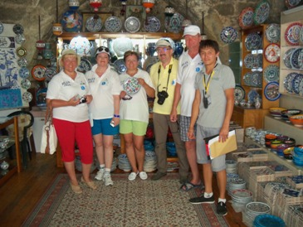
TREASURE HUNT TEAM BUILDING ACTIVITY OLD CITY-ANTALYA 2015

Slide 2
[BENEFITS]
ELEMENTS ASSERTED BY THE “TREASURE HUNT OLD CITY“
Communication | Interaction | Self managed teams | Developing strategies
Self confidence | Time management | Different opinions | Synergy
Support&harmony | Trust in the team | Empathy | Proactive approach
Active problem solving | Motivation | Setting objectives | Adapting to the team
Outcome orientation | Helping each other | Sharing and responsibility | Leadership

Slide 3
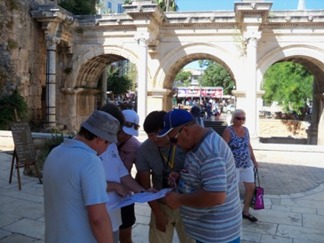
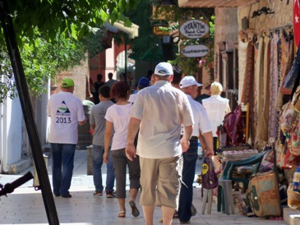
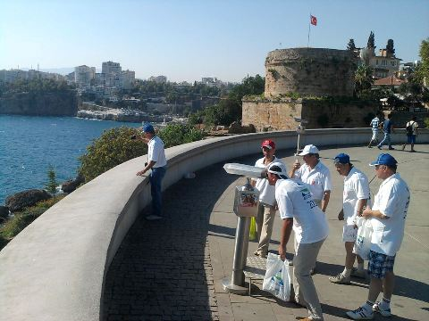
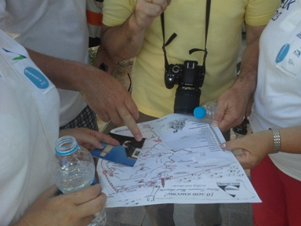
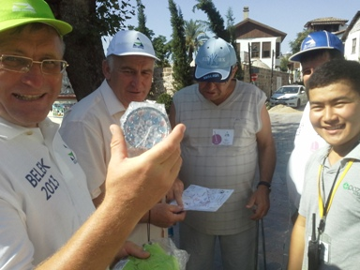
[STAGES OF “TREASURE HUNT OLD CITY”]
DETERMINE OF THE LOCATION
OLD CITY STREETS
MISSIONS
DISCOVERING THE
OLD CITY
FINDING PHOTOS
TREASURE

Slide 4
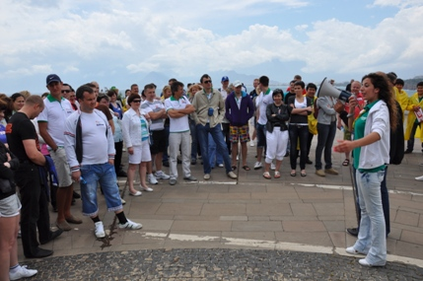
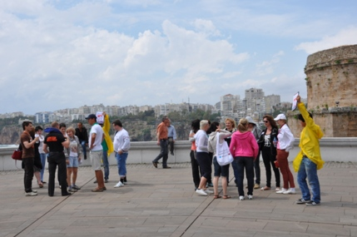
[GETTING ACQUAINTED AND FORMING TEAMS]
Objective;
Heating up and sharing information about the program
Informing about the activity
Getting to know the executive group
Grouping into predetermined teams
Accomodating the participants to the workshop environment

Slide 5
[PLANNING]
Objective
After reaching marked points that seems on the map; at each point questions and tasks are waiting for us. To reach the true points we need to find the shortest way from the map with a good planning.
Benefits
To determine strategy Communication Solving problems Timing Team spirit Synchronizing Sharing the ideas Making decisions Interaction Different ideas

Slide 6
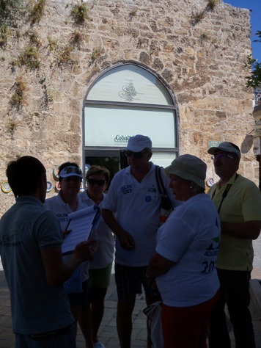
[ANSWERING THE QUESTIONS]
Objective
There will be questions and problems for every team at the determined points. The answers are hidden in Old City. If the teams can give the true answers they can move along to other points. As such the teams work to discover the Old city of Antalya.
Benefits
Determine the goals Motivation Interaction Synergy Helping Self leading teams

Slide 7
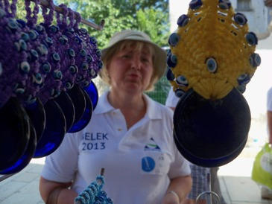
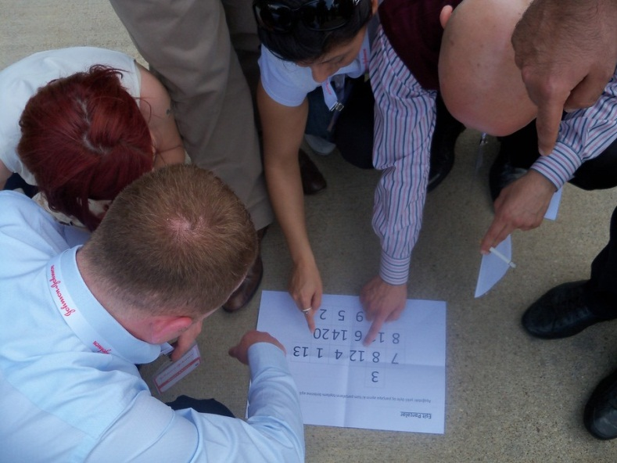
[ACCOMPLISHING THE TASKS ]
Objective
There will be some tasks that should accomplish by the teams. When they accomplish the missions they will reach other points.
Benefits
Team spirit Support and motivation Helping Trust in team Timing

Slide 8
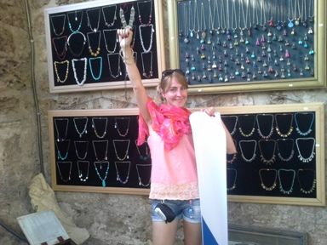
[REACHING THE TREASURE CHEST ]
Aim
Teams that answers all questions and accomplish all missions reach the treasures of anatolian.
Benefits
Team spirit Support and motivation Helping Trust in team Timing Responsibility

Slide 9
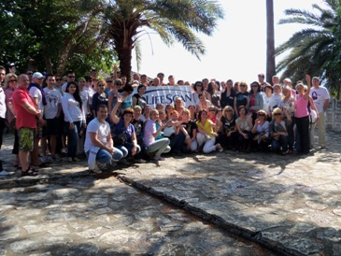
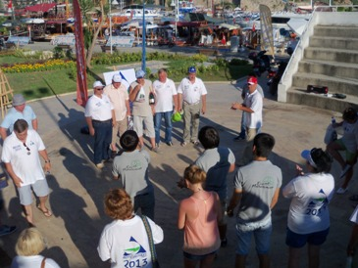
[FINALE]
Objective
Each team finds a treasures at point. The treasure pieces (turkish cofee, blue eye, spices, ceramics) are combined as a final. The team will win which the first contest treasure

Slide 10
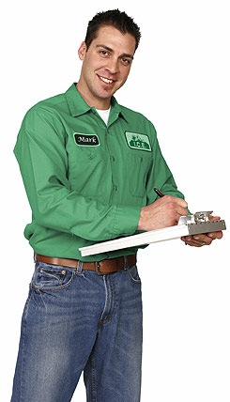
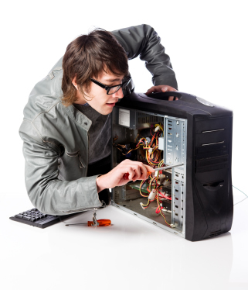
[EXECUTIVE TEAM]
Duties Of The Operation Team
Checking the teams and the time flow, Ensuring a smooth flow of the operation Ministering that the set-up is fully completed
Duties Of The Technical Team
Start setting-up one day before the activity Achieving field set-up Accomplishing cutting up with electric equipment
Duties Of The Activity Managers
Guiding the teams Assuring that the teams’ motivation keeps high Ensuring that the activities run parallel Evaluating the performences of the teams

Slide 11
[TIME TABLE]
ACTIVITY STEPS | TIME
ACQUAINTANCE&INFO | 14:00-14:10
FORMING TEAM | 14:10-14:15
HEATING UP | 14:15-14:20
ASSESSMENT | 14:30-14:35
QUESTIONS | 14:35-15:30
MISSIONS | 15:30-16:00
REACHING THE TREASURE | 16:30
FINALE | 16:30

Slide 12
[COSTING]
Services That Are Included In The Proposal:
Execution of the activities in the program
Services That Are Not Included In The Proposal:
Permisson for the activity area and expenses for such, if required Personnel hosting expenses Transfer of personnel and all transportation expenses Awards and promotional materials, if required Hosting, food and drink expenses of the activity team during the activity working hours The sound system Professional photography and video recording.

Slide 13
[GRATITUDE]
THANKS A LOT

