Slide 1
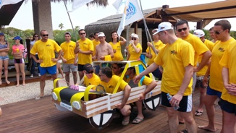
FAST AND FUNNY TEAM WORK ACTIVITY 2015

Slide 2
[FINCTION ]
FINCTION | The teams will design a concept vehicle with the materials given. Then the competitions sets; Best design Best performance
EMPHASIS | Of the brand on-site by the employees of the unit teams strive to be the best in the day. In this process, the teams fight with each other in the categories of design and performance. Being part of a team highlighted how important it is to the success of the institution.

Slide 3
[BENEFITS]
ELEMENTS ASSERTED BY THE “FAST AND FUNNY“
Communication | Interaction | Self managed teams | Developing strategies
Self confidence | Time management | Different opinions | Synergy
Support&harmony | Trust in the team | Empathy | Proactive approach
Active problem solving | Motivation | Setting objectives | Adapting to the team
Outcome orientation | Helping each other | Sharing and responsibility | Leadership

Slide 4
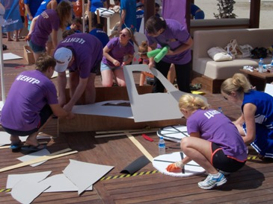
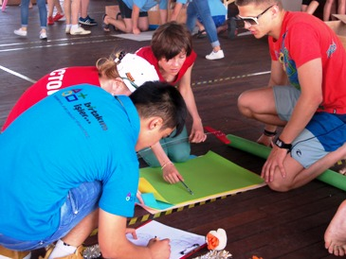
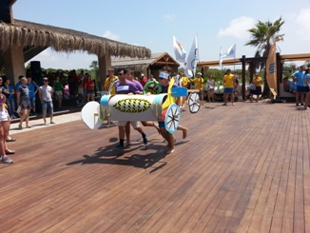
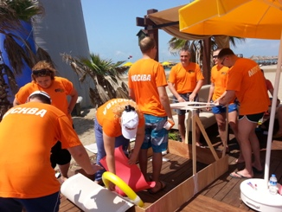
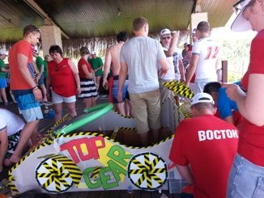
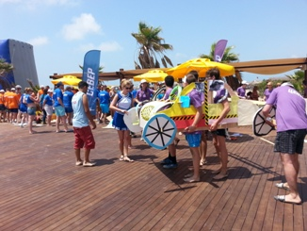
[STAGES OF THE “FAST AND FUNNY” ACTIVITY]
PIECES
VISUALS
RACE
ASSEMBLY
BEST DESİNG
PERFORMANCE

Slide 5
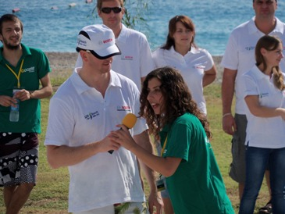
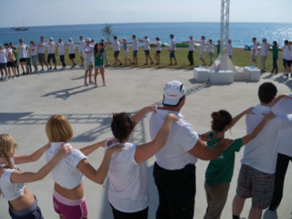
[GETTING ACQUAINTED AND FORMING TEAMS]
Objective;
Heating up and sharing information about the program
Informing about the activity
Getting to know the executive group
Grouping into predetermined teams
Accomodating the participants to the workshop environment

Slide 6
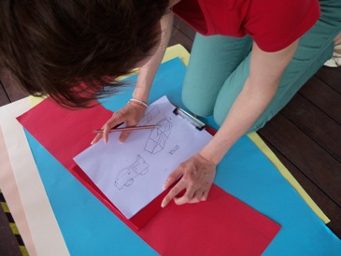
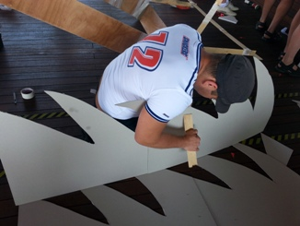
[PROJECT ASSESSMENT]
Objective
Studying the project and establishing a strategy Designing a race car with the materials provided Performing in parallel to the project
Benefits
Emphasising strategy development
Effective communication
Problem solving
Adapting to the team
Synchronised action
Exchanging ideas
Decision process
Interaction
Different opinions

Slide 7
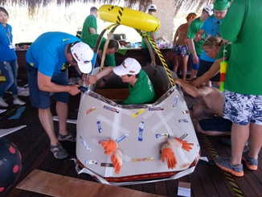
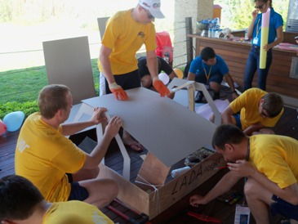
[ASSEMBLY-SETUP]
Objective
Responsibilities are assigned after the needs are assessed.To make best use of the restricted materials at hand, the teams have to calculate wisely
Benefits
Setting objectives
Problem solving
Active problem solving
Motivation
Self managing teams
Interaction
Different opinions

Slide 8
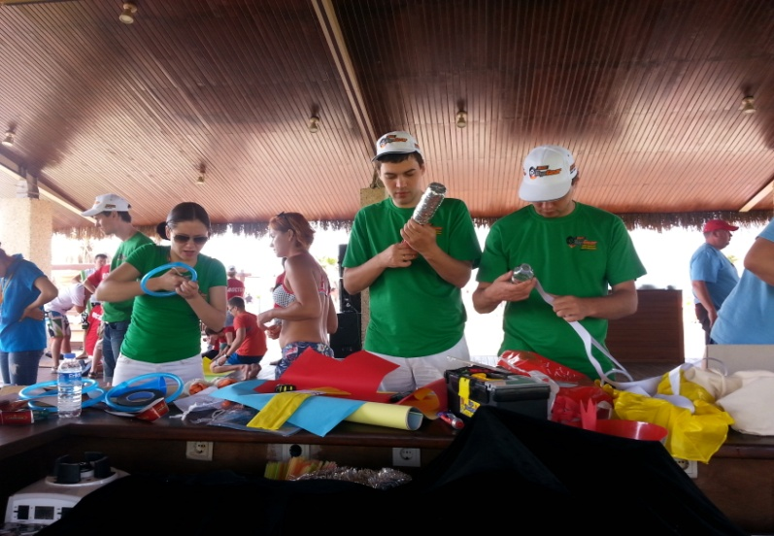
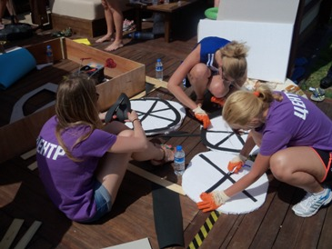
[VISUALS]
Objective
Race cars are given life by the imagination of the teams By using their imagination teams try to make the best designs with the limited amount of materials
Benefits
Production of creative ideas
Motivation
Emphasis on slogan and concept
Active problem solving
Self managing teams
Synergy
Different opinions

Slide 9
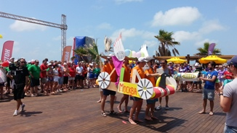
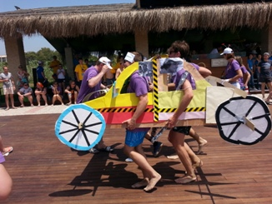
[RACE 1: BEST PERFORMANCE]
Objective
Teams race with the race cars they have built. Cars are rolled down a slope and the car that goes furthest eliminates the others.
Benefits
Team harmony
Motivation and team support
Time management
Helping each other
Responsibility and ownership
Synergy

Slide 10
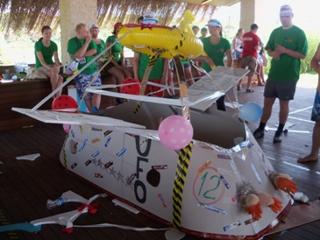
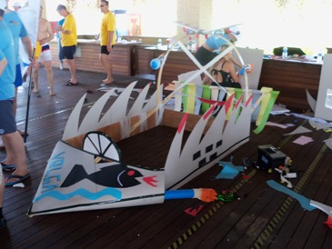
[RACE 2: BEST DESIGN]
Objective
The jury selects the best designed race car. Teams force the limits of creation in the activity where interesting designs are produced
Benefits
Team harmony
Motivation nad team support
Helping each other
Time management
Responsibility and ownership
Synergy

Slide 11
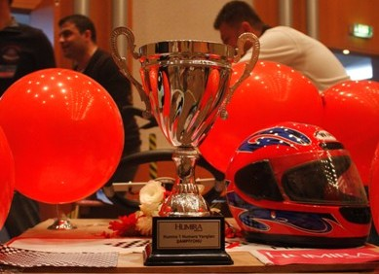
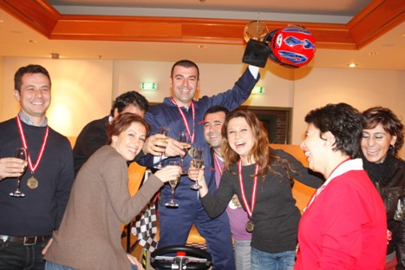
[FINALE]
Finale
During the day, teams compete to get the shortest times and win the race. Evaluation is on: Best design Best performance Successful teams are determined at the end of the day.

Slide 12
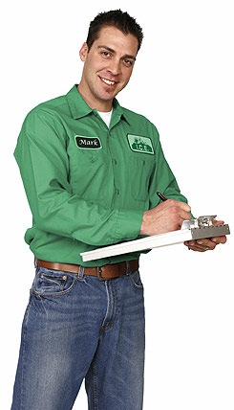
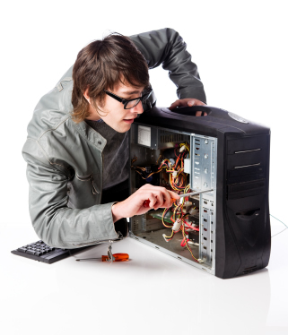
[EXECUTIVE TEAM]
Duties Of The Operation Team
Checking the teams and the time flow, Ensuring a smooth flow of the operation Ministering that the set-up is fully completed
Duties Of The Technical Team
Start setting-up one day before the activity Achieving field set-up Accomplishing cutting up with electric equipment
Duties Of The Activity Managers
Guiding the teams Assuring that the teams’ motivation keeps high Ensuring that the activities run parallel Evaluating the performences of the teams

Slide 13
[TIME TABLE]
ACTIVITY STEPS | TIME
GETTING ACQUAINTED &INFO | 13:30-13:45
PROJECT ASSESSMENT | 13:45-14:00
ASSEMBLY | 14:00-15:00
DESIGN AND BUILD | 14:00-15:00
DESIGN COMPETITION | 15:00-15:30
PERFORMANCE COMPETITION | 15:30-16:30
FINISH | 17:00

Slide 14
[COSTING]
Services That Are Included In The Proposal:
Execution of the activities in the program
Services That Are Not Included In The Proposal:
Permisson for the activity area and expenses for such, if required Personnel hosting expenses Transfer of personnel and all transportation expenses Awards and promotional materials, if required Hosting, food and drink expenses of the activity team during the activity working hours The sound system Professional photography and video recording.

Slide 15
[GRATITUDE]
THANKS A LOT

